Slide 1


Analysis of Network Outage Reports
Cybersecurity and Communications Reliability Division – Public Safety & Homeland Security Bureau
Jay Bennett
December 2021

Slide 2
Data Source
Database snapshot as of November 8, 2021
NORS Final Outage Reports from
January 1, 2013 through September 30, 2021 were used in the analysis

Slide 3
Frequency Trend Analyses
Past trend and seasonality effects
  Estimates used in trend chart
  Based on 3-year window (3Q18 – 2Q21)
Most recent trend
  Comparison with past trend
  Based on 3-year window (4Q18 – 3Q21)
Average monthly frequency (3Q21)
  Test if significantly different from expected frequency based on past trend and seasonality effects

Slide 4
Analyses Using
OC3 Outage Reports
OC3 Non-Simplex Outage Reports
  Included in all analyses
OC3 Simplex Outage Reports
  Analyzed separately
  Excluded from all other analyses unless noted otherwise

Slide 5
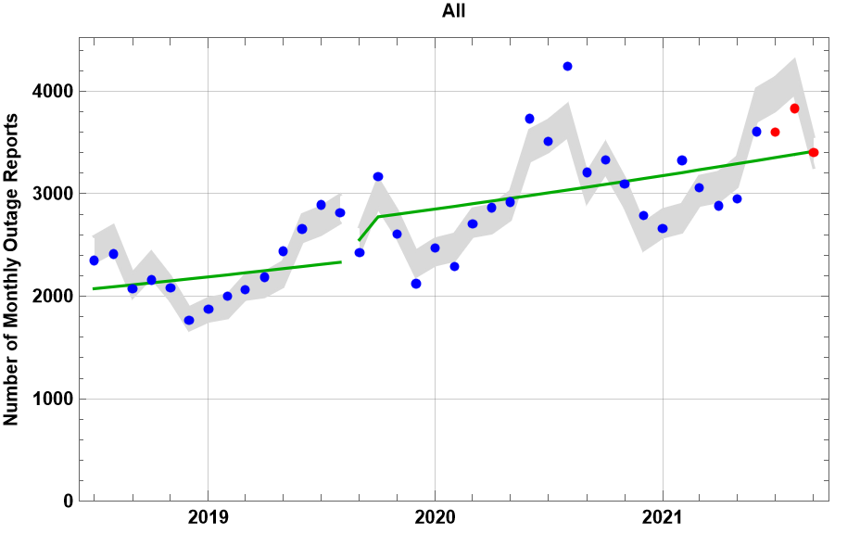
Frequency of Outages by Month
Monthly Trend
0.9%
(Current 0.7%)
3Q21 Monthly Average
3611
(significantly lower than expected)

Slide 6
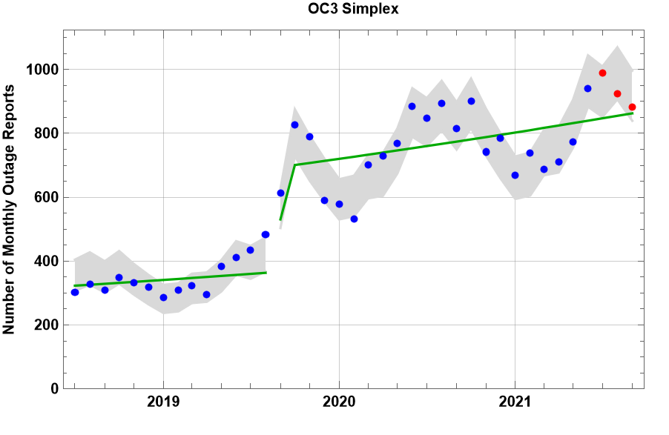
OC3 Simplex
Monthly Trend
0.9%
(Current 0.7%)
3Q21 Monthly Average
932

Slide 7
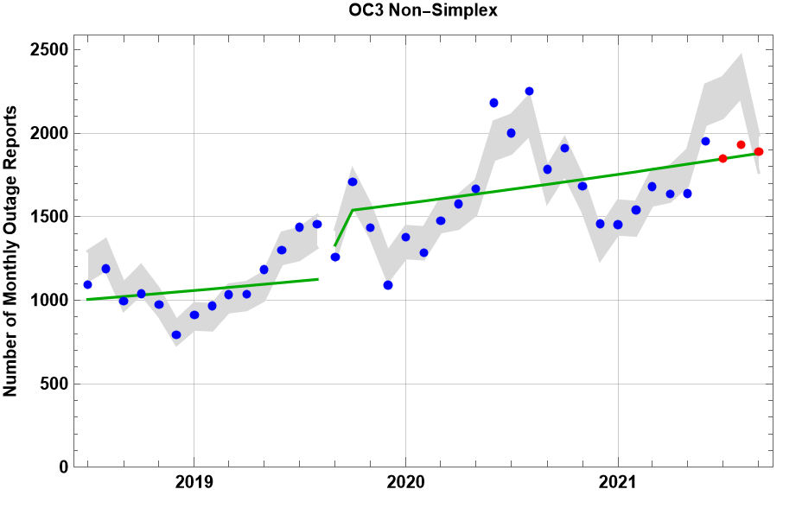
OC3 Non-Simplex
Monthly Trend
0.9%
(Current 0.4%)
3Q21 Monthly Average
1890
(significantly lower than expected)

Slide 8
Large OC3 Non-Simplex Outages

Slide 9
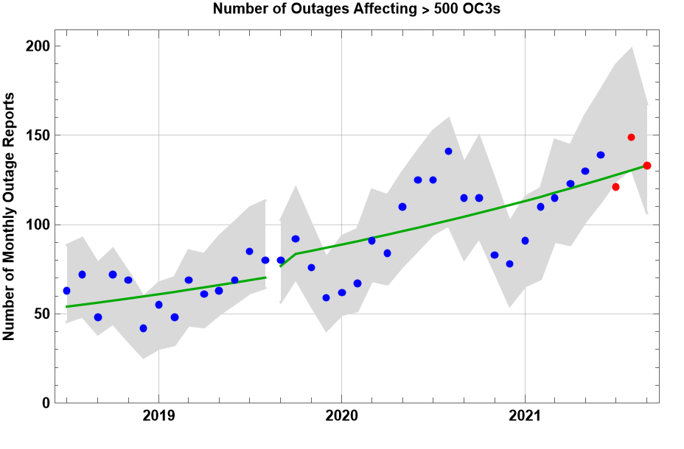
Large OC3 Non-Simplex Outages
Monthly Trend
2.0%
(Current 1.6%)
3Q21 Monthly Average
134

Slide 10
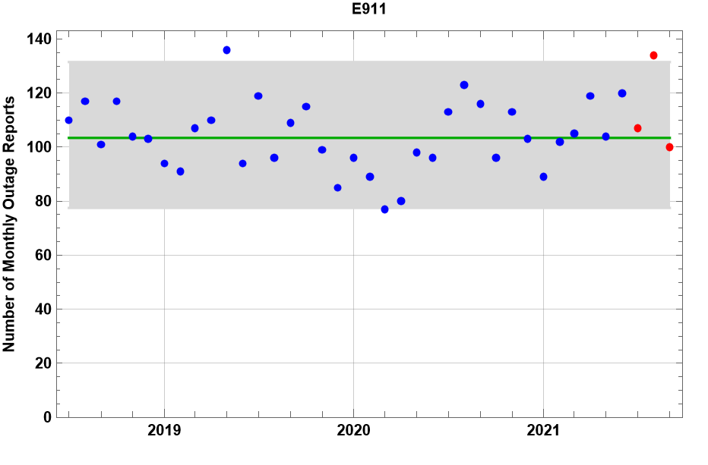
E911
Monthly Trend
0%
(Current 0%)
3Q21 Monthly Average
114

Slide 11
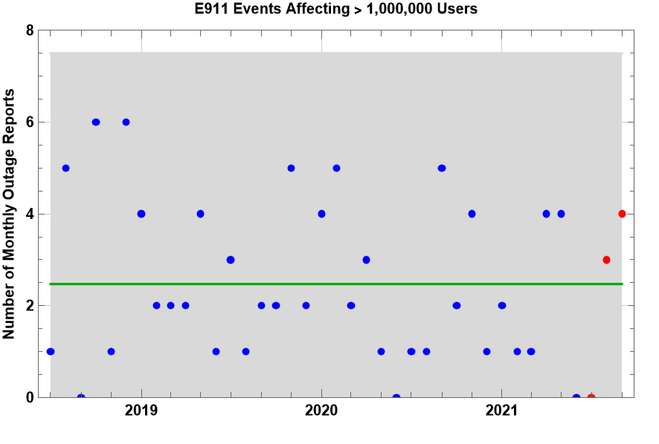
Very Large E911 Outages
Monthly Trend
0%
(Current 0%)
3Q21 Monthly Average
2.3

Slide 12
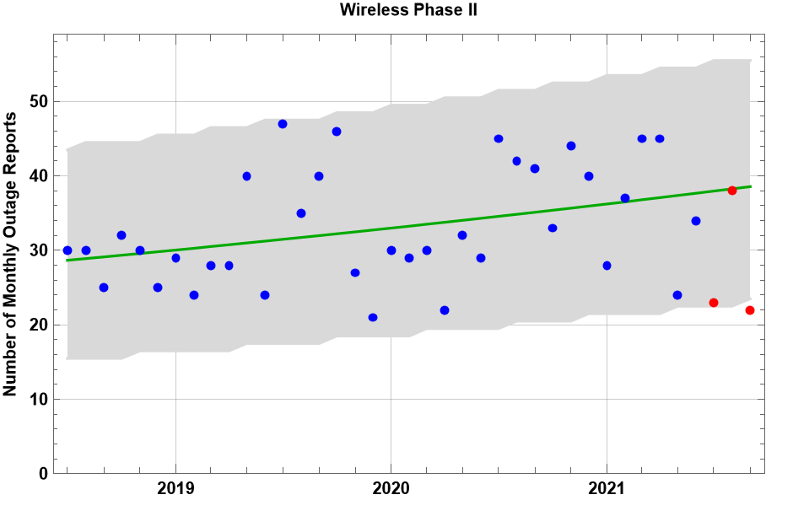
E911 – Phase 2 Events
Monthly Trend
0.8%
(Current 0%)
3Q21 Monthly Average
28
(significantly lower than expected)

Slide 13
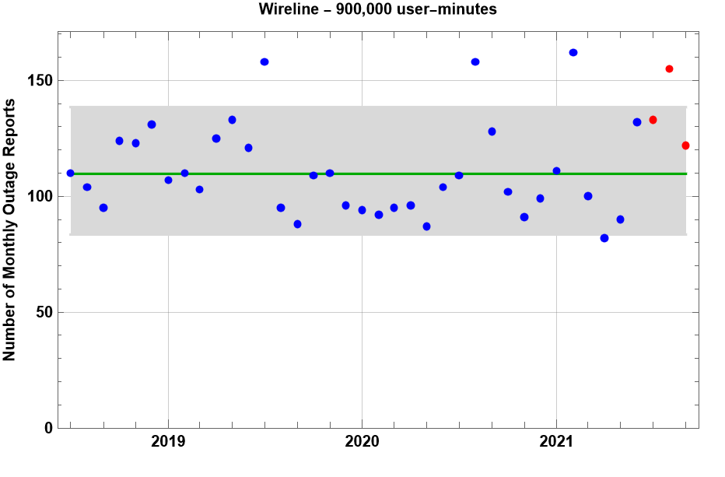
Wireline
Monthly Trend
0%
(Current 0%)
3Q21 Monthly Average
137
(significantly higher than expected)

Slide 14
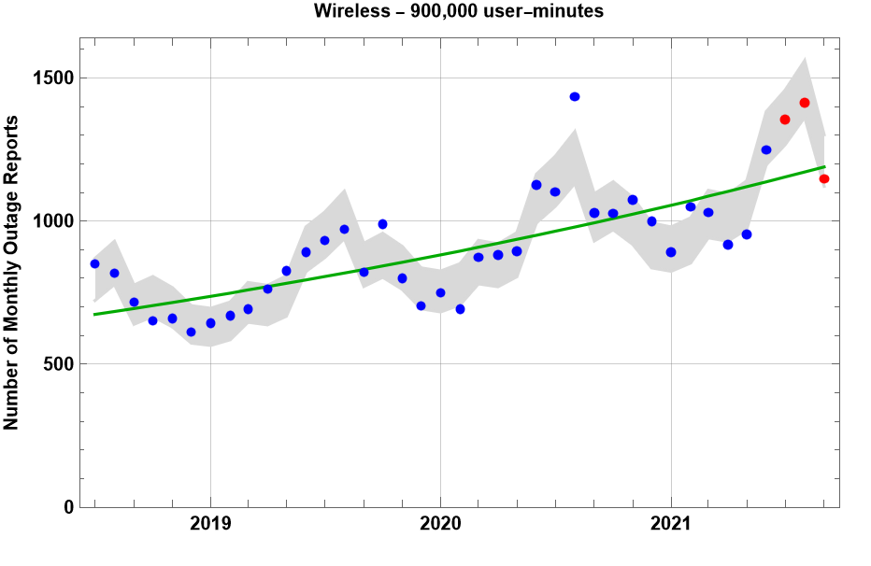
Wireless
Monthly Trend
1.5%
(Current 1.5%)
3Q21 Monthly Average
1305

Slide 15
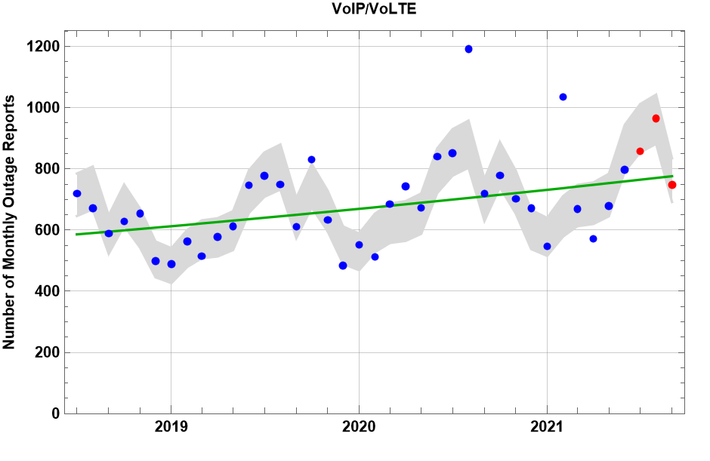
VoIP/VoLTE
Monthly Trend
0.7%
(Current 0.6%)
3Q21 Monthly Average
856

Slide 16
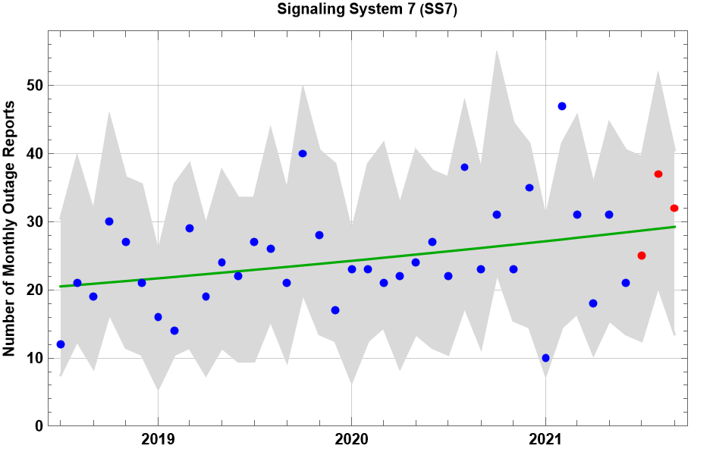
SS7
Monthly Trend
0.9%
(Current 0%)
3Q21 Monthly Average
31

Slide 17
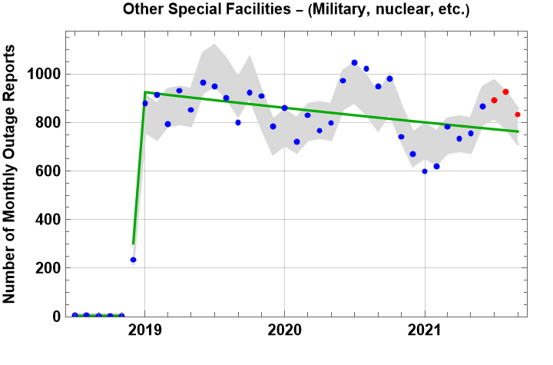
Special Facilities Outages
Monthly Trend
-0.6%
(Current -0.5%)
3Q21 Monthly Average
884

Slide 18
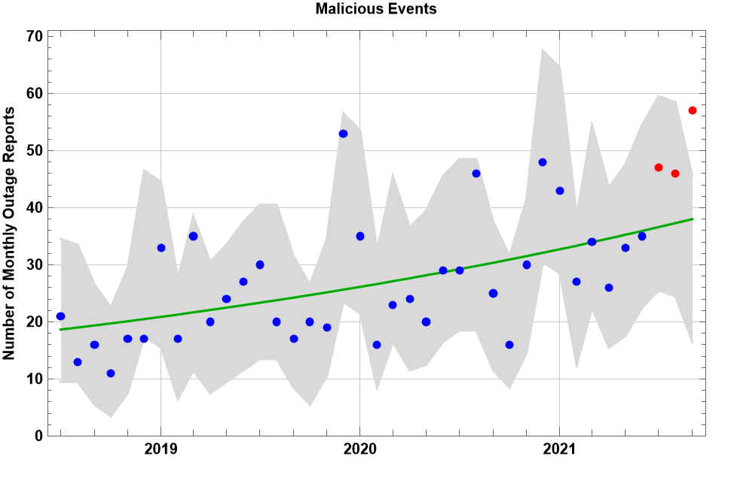
Malicious Events
Monthly Trend
1.9%
(Current 2.1%)
3Q21 Monthly Average
50
(significantly higher than expected)

Slide 19
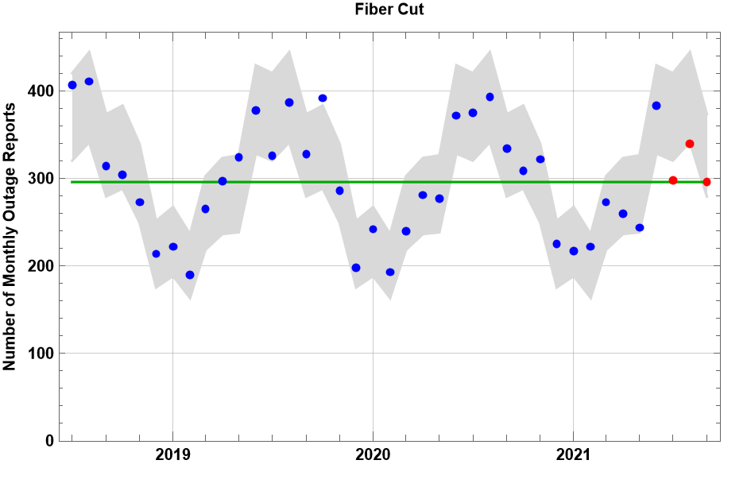
Fiber Cut
Monthly Trend
0%
(Current 0%)
3Q21 Monthly Average
311
(significantly lower than expected)

Slide 20
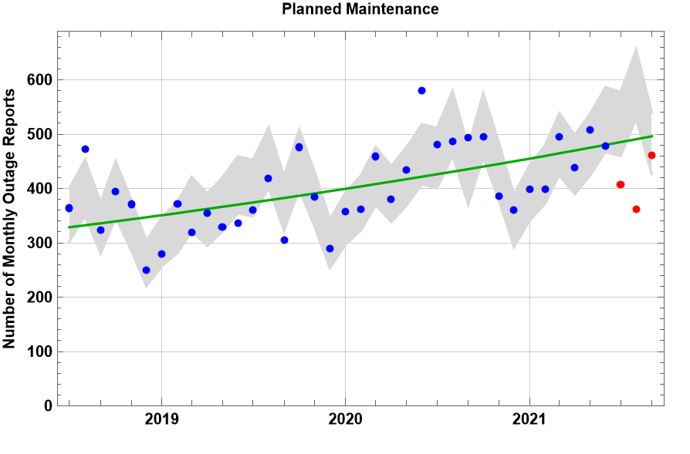
Planned Maintenance
Monthly Trend
1.1%
(Current 0.9%)
3Q21 Monthly Average
410
(significantly lower than expected)

Slide 21
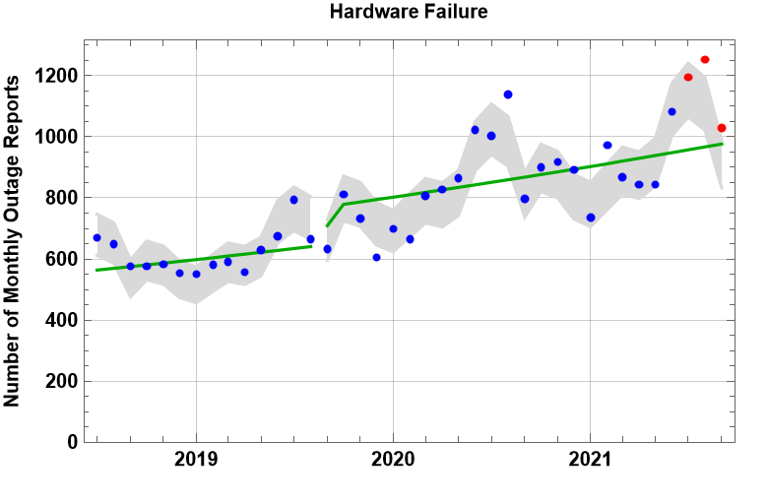
Hardware Failure
Monthly Trend
1.0%
(Current 1.3%)
3Q21 Monthly Average
1159
(significantly higher than expected)

Slide 22
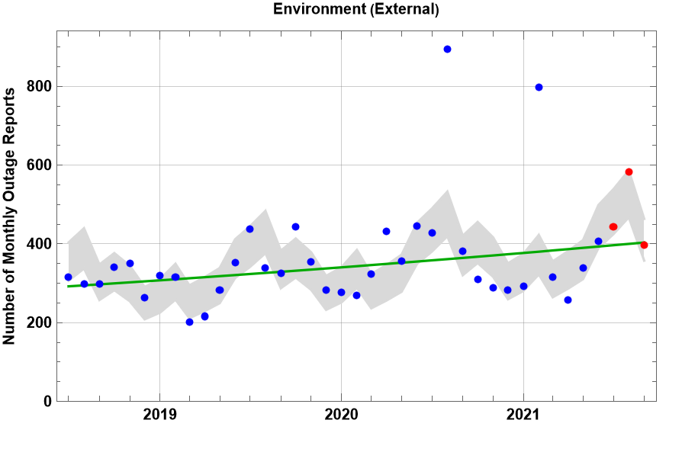
Environmental – External
Monthly Trend
0.9%
(Current 0.6%)
3Q21 Monthly Average
474

Slide 23
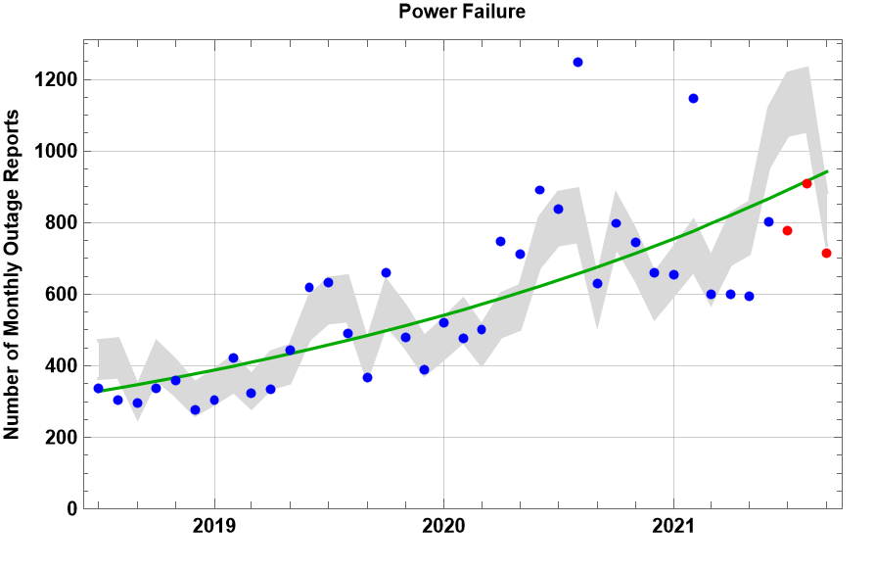
Power Failure
Monthly Trend
2.8%
(Current 2.2%)
3Q21 Monthly Average
801
(significantly lower than expected)

Slide 24
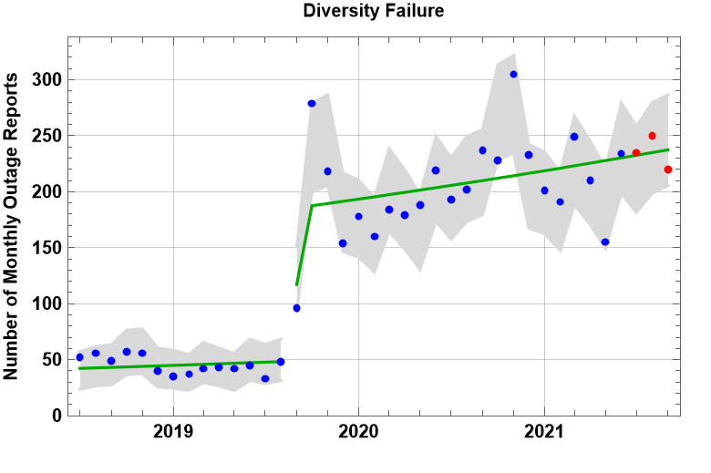
Diversity Failure
Monthly Trend
1.0%
(Current 1.2%)
3Q21 Monthly Average
235

Slide 25

Duration Trends: OC3 Non-Simplex
Through September, durations in 2021 have not been statistically different from 2020.

Slide 26
Duration Trends: E911
Through September, durations in 2021 have not been statistically different from 2020.
7

Slide 27
Duration Trends: Wireless
Through September, durations have been significantly longer in 2021 compared with 2020.
19

Slide 28
Duration Trends: VoIP
Through September, durations in 2021 have been significantly shorter than in 2020.
8.1

Slide 29
Duration Trends: Wireline
Through September, durations in 2021 have not been statistically different from 2020.

Slide 30
Duration Trends: OC3 Simplex
Through September, durations have not been statistically different from 2020.

Slide 31
Test for Trend in Event Duration
31
Non-OC3-Simplex outages
from October 2018 thru
September 2021
OC3-Simplex events
from October 2018 thru
September 2021
Rank Correlation of duration with date is .050 and is statistically significant.
Rank Correlation of duration with date is .061 and is statistically significant.
Conclusion: Durations of Non-OC3-Simplex outages have increased over the period from October 2018 thru September 2021.
Conclusion: Durations of OC3-Simplex events have increased over the period from October 2018 thru September 2021.

Slide 32
Outages In Progress
OC3 Non-Simplex

Slide 33
Outages In Progress
Other Service-Affecting Outages

