Slide 1
Enterprise Identity Network on
Distributed Ledger Technology
ATIS – DLT Focus Group
Companies Including:
First Orion, Inteliquent, Numeracle, T-Mobile, IBM, TNSI, Metaswitch
August 6th, 2020

Slide 2


What is Blockchain and Distributed Ledger Technology?
Distributed Ledger Technology
  Family of technologies that includes blockchain where a ledger is maintained by a group of peers rather than a single central authority [exception for “permissioned” ledgers]
  Builds on proven technologies including distributed computing, cryptographic encryption, and hashing
Blockchain
  A type of distributed ledger that organizes data in blocks, and updates the entries using an append-only structure
  Cryptocurrencies, such as Bitcoin, pioneered blockchain technology
Properties of Distributed Ledger Technology
Distributed
Shared ledger for full transparency
Time-stamped
Transaction timestamp is recorded on block
Anonymous
Identity of participants is either pseudonymous or anonymous
Programmable
Smart contracts
generate instructions for downstream processes if reference conditions are met
Mutual consensus
Good behavior of a majority of identified validator nodes
Secure
Encryption technologies enables security and anonymity of data
Immutable
Permanent, indelible, and unalterable history of transactions

Slide 3
ATIS DLT Focus Group
Background
DLT Focus Group - Established May 2018
  Validate key aspects of distributed ledger technology (DLT) as it applies to real-world challenges facing today’s communications industry
Objective:
  Deep dive of use cases, identify key issues where industry collaboration can benefit from DLT based solution
  Validate whether a distributed ledger solution can be demonstrated as viable
Goal:
  Identify a use case for a collaborative Proof of Concept (PoC) related to distributed ledger
  An effective PoC not only solves problems currently plaguing the industry but can also lead to further business opportunities
Trust
Asset Control
and Supply
Chain
Authentication
Identity
4

Slide 4







Enterprise Identity & Trusted Telephone Numbers
Use Case – Problem Statement
Enterprise Identity :
Effective vetting of Enterprise creates barrier to entry
Not a universal process or portable
Difficulty Attesting to a TN:
TN can be provided from multiple sources
Brand is the owner, 3rd party making calls on their behalf
Place calls through multiple routes
TN Providers
TN Resellers
?
Brands
Call Centers
Originating
Service Providers
Terminating
Service Providers
Originating Carriers cannot attest to a number they do not own or manage.

Slide 5




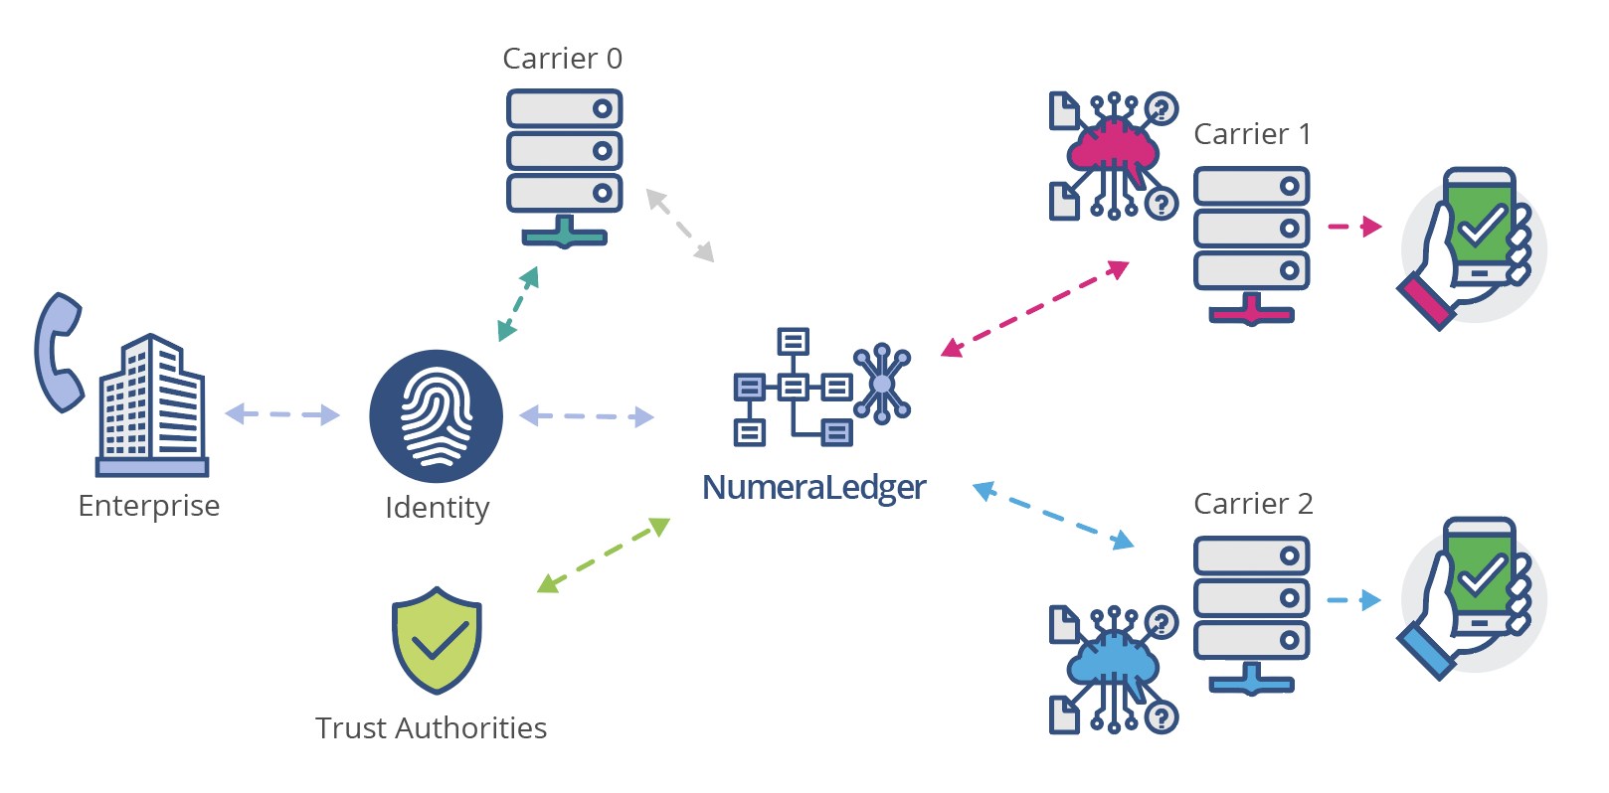
Enterprise Identity Distributed Ledger Network
Addressing KYC Vetting and Proof of identity
KYC Vetter
Vetting
Process
TN Providers
Enterprise
Identity DL
Network
TN Assignment
Enterprise
Enterprise
Digital
Identity
Private Permissioned
Distributed Ledger
TN Resellers
Enterprise vetted once and stored within DLT
An Enterprise is vetted by a KYC Vetter and their Digital Identity is ‘Proofed’
To allow ‘Trusted’ TN assignment by any TNSP or TNR
Enable anyone in the call path to verify the caller identity

Slide 6
Enterprise Identity Distributed Ledger Network
Use of Trusted Telephone Numbers
Enterprise
Identity DL
Network
Private Permissioned
Distributed Ledger
TNSP
TN Resellers
?
Brands
Call Centers
Originating
Service Providers
Terminating
Service Providers
Any stakeholder using the Enterprise Identity DL can authenticate the use of a ‘Trusted’ TN without the need to have any predefined business arrangement with an Enterprise.

Slide 7



Enterprise Identity Distributed Ledger Network
Business Value & Advantages
  Increases enterprise customer acquisition and competitiveness
  Increases TN integrity to mitigate fraud
  Increases the value of the Telephone Number
Cross Border Interworking
Global support
  Improves network infrastructure & switching efficiencies
Improved level of trust and regulatory compliance
Reduces the barrier to entry for Enterprise Identity, improving the overall effectiveness of SHAKEN service.

Slide 8









Enterprise Identity Distributed Ledger Network
Participating Companies
KYC Vetter
Enterprise
Identity DL
Network
TN Providers
TN Resellers
?
‘Brand’
Enterprise
Call Centers
Called Parties
OSP
TSP
Notes:
The specific use case that we are working on for a proof of concept uses a distributed ledger to register and authenticate trusted identities used by all participants together with Enterprise TN assignment data ,
Whereby anyone in the call path connected to the Enterprise Identity network DL can authenticate the caller identity and if they are authorized to lace calls with the TN ,
specifically for enabling the OSP to provide A attestation for SHAKEN in complex call scenarios .
With the following active member companies contributing to advance the project across specific areas of interest.
List them as:
IBM and IOTA for the Distributed ledger infrastructure
First Orion , for Enterprise Credentials management, call generation
Numeracle , for enterprise KYC vetting and authorisation
Inteliquent, for number management assignment and delegation authorisation,
First Orion for OSP call validation.
Tmobile, TNSi, Metaswitch for SHAKEN interworking
First Orion, Inteliquent, for RCD integration

Slide 9
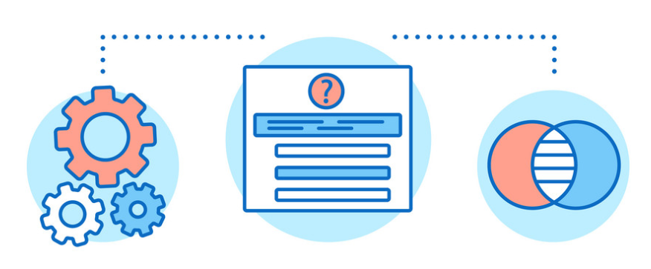
Enterprise Identity Distributed Ledger Network
Progress & Plan
Define appropriate technology standards and frameworks for implementation
Research & Specification
Publish Use Case specification in November 2019
Propose Technology standards for Integration
Submit EIDL
to IPNNI as
optional solution
IPNNI
EIDL
Specification
Agree Scope and Deliverables for
PoC Phase 1
(Smart Contract)
Demonstrate
PoC P1
Demonstrate
PoC P2
Development of
PoC P1
PoC Phase 2
Implement Agreed Standards (DID & VC)
Proof Of Concept
Agile Process
Validate Identity & TN Authorization on DLT
Validate interoperability
Technologies

Slide 10
Enterprise Identity Distributed Ledger Network
Structure of contribution to IPNNI
Define appropriate architecture, process and technology standards for implementation
Define the Business Architecture
  Model of the Trust Hierarchy
    How actors are authenticated onto the network
  Model of the TN Authorization hierarchy
    The order and path of TN allocation/assignments/delegation
    Governance around privacy of information
SHAKEN Interworking Architecture
    Define the integration and interworking points with the SHAKEN Architecture
Appropriate technology open standards for decentralized:
    Identity Management
    Proof
    Interoperability
SIP PASSporT encoding

Slide 11
Enterprise Identity Distributed Ledger Network
Business Process Architecture
Trust Hierarchy
TN Authorization Hierarchy
Trust Authority
Numbering
Authority
TN Primary Number plan range allocation (NANPA) to a TNSP. Including any port corrected TN data (LNPA).
Trust Authority
Vets TNSPs
& KYC Vetter
TNSP 1
TNSP 2
TNSP Authority, will only assign ‘Trusted’ TNs that are to be used on the EIDL network.
Can assign to a TNR or delegate to Brand for use.
CSP
TNSP 1
TNSP 2
KYC Vetter 1
KYC Vetter 2
TNR 1
TNR 2
KYC Vetter
Vets and
Authorizes
Enterprise
Identity to
organizations
TNR can delegate a TN to a Brand Enterprise to place ‘Trusted’ calls.
Brand 1
Brand 2
TN Reseller 1
TN Reseller 2
BPO 1
Brand 1
BPO 2
Brand 2
Brand can delegate a TN they have been assigned to a BPO to place calls on their behalf.
BPO 1
BPO 2
Notes:
In defining the Enterprise Identity service on DLT, we needed to go beyond the carrier to carrier attestation.
As part of architecting the solution , it was important to understand the business logic and architecture of stakeholder relationships, to develop a governance thrust hierarchy for stakeholder authorisation on to the service,
Likewise , it was important to map out the business process and flows for TN assignments and delegations, which as we now know is a very complex scenario.
Understanding of both of these were significant in setting the identity design model for the implementation of the service on a distributed ledger technology

Slide 12
Enterprise Identity Distributed Ledger
Integration Architecture with SHAKEN
Trust
Authority
Numbering
Authority
KYC
Vetter
Authorization
TNSP
Number Management
TNR
Number Management
Brand
Number Management
Business Process
HTTPS
HTTPS
HTTPS
HTTPS
HTTPS
HTTPS
Enterprise Identity Distributed Ledger Network
HTTPS
HTTPS
EI-VS
STI-AS
Certificate
Provisioning
Service
HTTPS
STI-CR
SHAKEN
Architecture
Enterprise Credential API
HTTPS
HTTPS
Enterprise PASSporT
SKS
STI-VS
RPC
CVT
Identity Authentication
Process
Credential Mng
SIP
SIP
Enterprise PASSporT
CSCF
CSCF
SIPS
SIPS
SIP
SIPS
SIP
SKS
SIP UA
IBCF/
TrGW
IBCF/
TrGW
SIP UA
SRTP
SRTP
SRTP
Enterprise Caller
Brand & BPO
Service Provider A
Originating/Authorization
Service Provider B
Terminating/Verification
  Enterprise Identity DLT solution as an option for “A” attestation of Enterprise originated calls

Slide 13





Technology Standards
Self Sovereign Identity
The premise of SSI is that it’s an identity you fully own — there is no central entity that manages that relationship. Whenever you want to establish your identity you can present “claims” about your identity that can be subsequently verified with cryptographic certainty by the authority that wants to check it.
TRUST
Any person, organization, or thing can instantly verify the authenticity of “claims,” including who (or what) something claims to be.
PRIVACY
Complete control of how, what and when information is shared, without added risk of correlation and without creating troves of breachable data
TRUE SELF-SOVEREIGNTY
Any person, organization, or thing can actually own their digital identity – not just control it – independent from any silo.
(DID) Decentralized Identifiers
(VC) Verifiable credentials
(DPKI) Distributed PKI
Standard developed by W3C for implementation on DLT

Slide 14

W3C - Decentralized Identifiers (DID)s
DID document
is a JavaScript Object Notation for Linked Data (JSON-LD) file containing.
DID format
is similar to Uniform Resource Name (URN) format.
cc2cd0ffde594d278c2d9b432f4748506a7f9f25141e485eb84bc188382019b6
On DLT
The DID itself for the identified entity
A set of public keys or other proofs that can be used for authentication or interaction with the identified entity
A set of service endpoints that describe where and how to interact with the identified entity
Timestamps of creation or update of a particular DID
Signature added to verify the integrity of the document
Public Key
did:ibm:3k9dg356wdcj5gf2k9bw8kfg7a
Private
Key
047d599d4521480d9e1919481b024f29d2693f272d19473dbef971d7d529f6e9
In SKS

Slide 15
Enterprise Identity Distributed Ledger Network
Actor Decentralized Identifier (DID)
The basic format of an enterprise identity actor DID document:
"@context": ["https://www.w3.org/ns/did/v1", "https://w3id.org/security/v1"],
"id": "did:ibm:123456789abcdefghi",
"publicKey": [{
"id": "did:ibm:123456789abcdefghi#key-1",
"type": "Ed25519VerificationKey2018",
"controller": "did:ibm:123456789abcdefghi",
"publicKeyBase58": "H3C2AVvLMv6gmMNam3uVAjZpfkcJCwDwnZn6z3wXmqPV"
}]
}

Slide 16
Enterprise Identity Distributed Ledger Network
Actor Decentralized Identifier (DID)
Enterprise Identity Distributed Ledger Network
KYCV1:DID Identity:
DID Document
Public Key
ENT1:DID Identity:
DID Document
Public Key
OSP1:DID Identity:
DID Document
Public Key
KYC Vetter
Brand Enterprise
OSP
EIDL
Credential Mgmt
EIDL
Credential Mgmt
EIDL
Credential Mgmt
Wallet
(SKS)
KYCV1:DID Identity:
Private Key
DID Public Key Path
Wallet
(SKS)
ENT1:DID Identity:
Private Key
DID Public Key Path
Wallet
(SKS)
OSP1:DID Identity:
Private Key
DID Public Key Path

Slide 17
W3C - Verifiable Credentials (VC)
Potentially long-lived electronic credentials that users store under their control and use to identify themselves whenever they wish to access electronic resources.
Electronic equivalent of today’s plastic cards, passports etc
Contain cryptographically protected identity attributes (PII)
Verifiable Credential is a JavaScript Object Notation for Linked Data (JSON-LD) file containing.
There are four roles supported by verifiable credentials:
  Issuer: The entity that creates a claim and associates it with a particular subject.
  Verifier: The entity verifying a claim about a given subject.
  Subject: The entity about whom a claim is issued.
  Holder: A role an entity may perform by possessing one or more verifiable credentials. A holder is usually, but not always, the subject of the verifiable credentials that they are holding. Holders store their credentials in credential repositories.

Slide 18
TN Allocation – Creation of DID and VC Process
Create VC and DID for TN Identity on EIDL
TN Authorisation Path
Numbering
Authority
VC: NA
Authorization
TN Allocation
DID:TN Identity
TNSP1 Allocation
TNR1 Assignment
Brand1 Delegation
BPO1 Delegation
TNSP 1
VC: TNSP1
Authorization
TN Assignment
TNR 1
VC: TNR1
Authorization
TN Delegation
Brand 1
VC: BRAND1
Authorization
TN Delegation
BPO 1

Slide 19
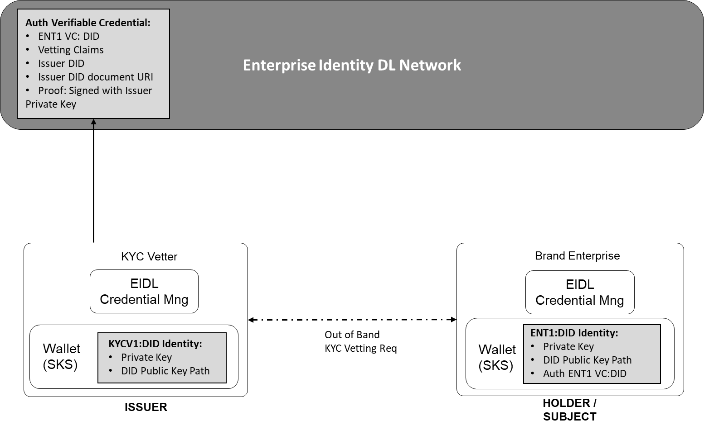
Enterprise Identity Distributed Ledger Network
Verifiable Credential - For KYC Vetter Authorization
W3C verifiable credential claim representing the KYC vetting status for an organization.
{
"@context": [
"https://www.w3.org/2018/credentials/v1",
"https://access.atis.org/apps/group_public/dlt/v1/"
],
"id": "did:ibm:<ENT1>",
"type": ["VerifiableCredential", "VettingStatus"],
"issuer": "did:ibm:<KYC1>",
"issuanceDate": "2020-01-01T19:73:24Z",
"credentialSubject": {
"id": "did:iota:<Brand Name of Enterprise>",
"organisationVettingStatus": "Authorized"
},
"proof": {...}
}

Slide 20
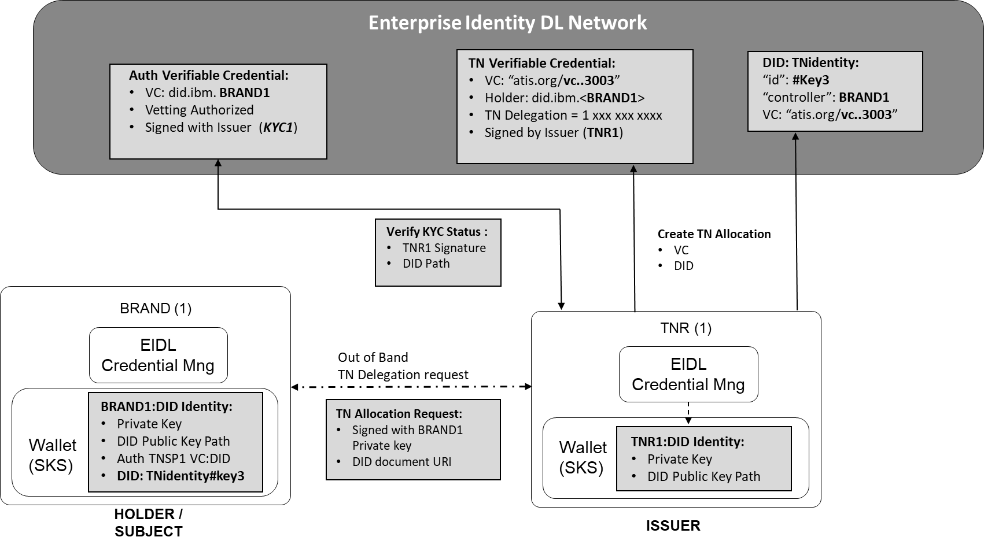
Enterprise Identity Distributed Ledger Network
Verifiable Credential – For TNR TN Delegation to a Brand Enterprise

Slide 21
Enterprise Identity Distributed Ledger Network
Verifiable Credential – For TNR TN Delegation to a Brand Enterprise
W3C verifiable credential claim representing the TN delegation
DID Document representing the TN Asset
{
"@context": [
"https://www.w3.org/2018/credentials/v1",
"https://access.atis.org/apps/group_public/dlt/v1/" ],
"id": "https://access.atis.org/credentials/3003",
"type": ["VerifiableCredential", "TN Authorization"],
"holder": "did:ibm:<BRAND1>",
"issuer": "did:ibm:<TNR1>",
"issuanceDate": "2020-01-01T19:73:24Z",
"credentialSubject": {
"id": "did:iota:<TNIDENTITY>",
"TN Authorization": {
"TN": "12002001234",
"Type": "Delegation",
“CallerName: “Big Bank”
“Purpose”: “Loan Application”
}},
"credentialStatus": {
"id": "https:// access.atis.org /status/24,
"type": "CredentialStatusList2017"
},
"proof": {...}
"id": "did:ibm:<TNIDENTITY>",
“authentication”:[{
“id”:”did:ibm:<TNIDENTITY#Key1>”,
“controller”:”did.ibm:<TNPS1>”
"publicKey": "H3C2AVv……." },{
“id”:”did:ibm:<TNIDENTITY#Key2>”,
“controller”:”did.ibm:<TNR1>”
“level”:”TopRestricted”
"publicKey": "LMv6g…………." },{
“id”:”did:ibm:<TNIDENTITY#Key3>”,
“controller”:”did.ibm:<BRAND1>”
“level”:”TopRestricted”
"publicKey": "LMv6g…………." },{}],
"Service":[{
“id”:”did:ibm:<TNIDENTITY#Key1>”,
“type”: "TN Authorization"
"tn":"12002001234",
“serviceEndpoint”:”https://access.atis.org/credentials/1001” },{
“id”:”did:ibm:<TNIDENTITY#Key2>”,
“type”: "TN Authorization"
"tn":"12002001234",
“serviceEndpoint”:”https://access.atis.org/credentials/2002” },{
“id”:”did:ibm:<TNIDENTITY#Key3>”,
“type”: "TN Authorization"
"tn":"12002001234",
“serviceEndpoint”:”https://access.atis.org/credentials/3003” },{
"proof": {...}

Slide 22
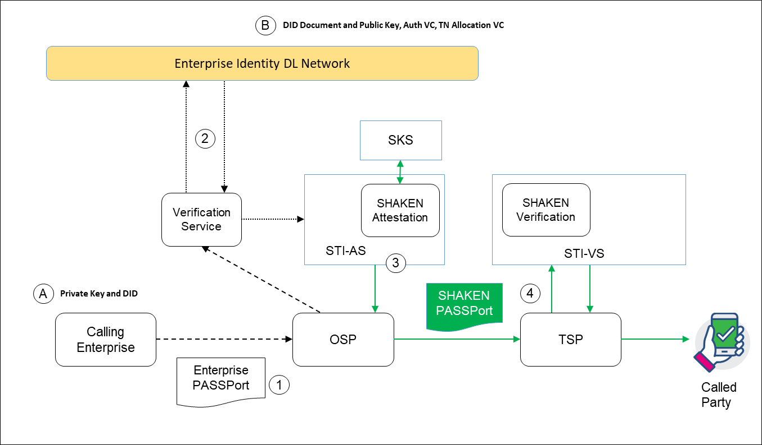
Enterprise Identity Distributed Ledger Network
SHAKEN Interworking call flow
Using the private key generate a PASSporT , including the DID of the caller identity.
The ‘Verification Service’, can verify the PASSport from the DID Document/Public key. Verify that both the identity is KYC vetted and the TN is authorized to be used by this DID.
If valid, the OSP STI-AS can apply “A” Attestation on the SHAKEN PASSporT.
The TSP verifies SHAKEN as usual.

Slide 23
Enterprise PASSport Encoding.
Option 1. Modified Base PASSporT
Protected Header
{
"typ":"passport",
"alg":"ES256",
“jku":”did:ibm:098765432abcdefghi”
}
Payload
{
"dest":{"tn":"12125551213 "},
"iat":1443208345,
"orig":"tn":"12155551212"},
“tnauth":“uri":["did:ibm:123456789hutnigk"]
}
DID of the Caller Identity used to authenticate the caller identity and using the private key to verify the PASSport
DID of the TN Assignment defined by the verifiable credential claim

Slide 24
Enterprise PASSport Encoding.
Option 2. "rcd" extension PASSporT
Protected Header
{
"alg":"ES256",
"typ":"passport",
“ppt”:”rcd”,
“jku":”did:ibm:098765432abcdefghi”
}
Payload
{
"dest":{“tn”:"12155551213"}
"iat":1443208345,
"orig":{“tn”:"12155551212"},
"rcd":{"nam":"Dentist Office"}
“tnauth":“uri":["did:ibm:123456789hutnigk"]
}
DID of the Caller Identity used to authenticate the caller identity and using the private key to verify the PASSport
DID of the TN Assignment defined by the verifiable credential claim

Slide 25
Draft Proposal for IPNNI
Working draft of Technical Report
Consideration as optional solution for Enterprise identity (ATIS-1000089)
Include broader audience to advance content
Worked on in DLT group and/or IPNNI interest group

Slide 26

Questions?

