Slide 1
IPNNI-2014-015
ATIS/SIP Forum NNI Task Force – Routing Team
January 15, 2014
Penn Pfautz
pp3129@att.com

Slide 2
Agenda
Introductions
Objectives
Analysis of NPAC as ENUM Registry Proposal

Slide 3
Objectives
From 12/10/2013 minutes:
The meeting agreed that a “routing” design team would work offline to flesh out a more detailed proposal using Penn’s initial proposal as a starting point. This design team would then bring a formal proposal back for consideration by the full task force.
Define interconnection topology/topologies to be supported
Including direct and indirect interconnection
Detail address resolution process
Define data exchanges required
Consider performance, security, economic impacts, globalization, and relation to non-E.164 PUID resolution

Slide 4
Work Plan
Initial solution definition and evaluation framework for 2/10 Miami meeting
Correspondence group/call in interim?
Complete detailed solution definition in Miami
Follow with member evaluations

Slide 5
Interconnection Topologies
National interconnection at small number of geographically diverse carrier hotels (like Internet Peering but with dedicated facilities)
Indirect interconnection through transit or IPX provider

Slide 6
NPAC as ENUM Registry

Slide 7
NPAC as ENUM Registry
NPAC capabilities can be used to instantiate a combined Tier 0/1 ENUM registry for the US
Existing VOICEURI field is re-purposed to contain NS record(s) which point to the Tier 2 ENUM server of the service provider of record for number
NS records are populated into NPAC by the serving provider SOA and distributed to each provider LSMS
Providers then populate the NS records in their internal ENUM servers
Originating provider queries its ENUM server and obtains the NS record resulting in a query to the Tier 2 ENUM server of the destination carrier.
The response to the Tier 2 query provides NAPTR records that identify the ingress SBC to be used to deliver the call to terminating provider.

Slide 8
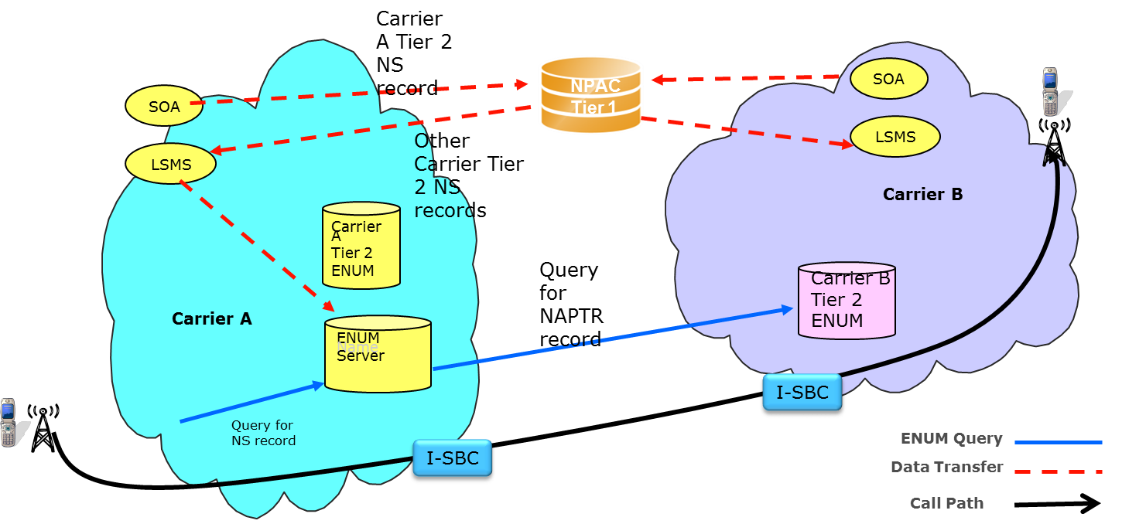
NPAC as ENUM Registry

Slide 9
NS Records in the VOICEURI Field
Populate NS info in VOICEURI field as just FQDN, tier2enum.serviceprovider.com, rather than full form 3.8.0.0.6.9.2.3.6.4.1.e164enum.net IN NS tier2enum.provider.net
Full record form reconstituted by the service provider for provisioning in its ENUM server
Multiple NS records could be populated in the NPAC VOICEURI field using separator character.
allows for redundant name server instances
An apex domain needs to be agreed upon

Slide 10
Tier 2 ENUM Server
Query to the service provider of record’s Tier 2 server has the normal (RFC 6116) form
Response would be the set of NAPTR records associated with the queried number
Tier 2 server is not constrained to be a vanilla DNS server; behind the ENUM query/response interface it might support whatever application of policy that the destination carrier desired
Query over same interconnection fabric that a subsequent SIP INVITE would traverse

