Slide 1
International SHAKEN
Jim McEachern
Principal Technologist
ATIS
January 2020

Slide 2
Outline
SHAKEN Trust Model
Cross-Border SHAKEN (ATIS-1000087)
International SHAKEN

Slide 3
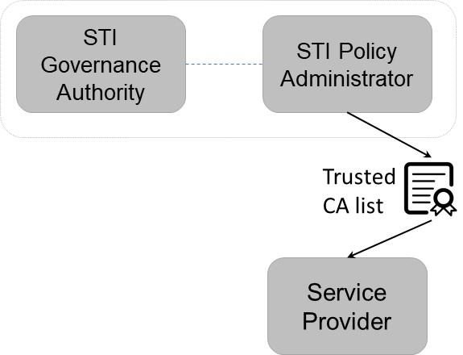
SHAKEN Trust Model
Trusted CA list effectively provides the root of trust for SHAKEN
Certification Authority (CA):
Must be authorized before being included on Trusted CA list
Ongoing monitoring/auditing for compliance
Service providers (SP):
Need credentials (i.e., Service Provider Code (SPC) token) to obtain STI certificates
Vetted before receiving SPC token
Terminating SP checks to see if STI certificate was issued by a CA on the Trusted CA list
If CA is not on the list, then verification automatically fails
ATIS-1000087: Mechanism for Initial Cross-Border Signature-based Handling of Asserted information using toKENs (SHAKEN)

Slide 4
Cross-Border SHAKEN (ATIS-1000087)
ATIS-1000087 merges Trusted CA lists:
OSP uses cert from “STI-CA 1” approved by STI-PA “1”
TSP checks local Trusted CA list provided by STI-PA “A”
STI-CA 1 is on the merged Trusted CA list, so verification can succeed
ATIS-1000087 recognizes this is an “initial mechanism”, and that an alternative approach will be needed for full “international” SHAKEN
ATIS-1000087: Mechanism for Initial Cross-Border Signature-based Handling of Asserted information using toKENs (SHAKEN)

Slide 5
International SHAKEN - Challenges
Using the strategy in ATIS-1000087 for all countries presents two challenges:
Requires a rigorous vetting process to ensure legitimacy:
Who would perform this vetting?
What objective criteria would be used?
How do you prevent the process from become more political than technical?
Difficult to get all countries to accept vetting process:
Reluctance to accept 3rd party vetting process
Unanimous consent on vetting process could be problematic
In some cases, countries will never unconditionally trust specific other countries, regardless of vetting process

Slide 6
International SHAKEN - Proposal
No matter how rigorous the vetting process, additional “validation” mechanism likely needed to prove and monitor compliance (at least in some circumstances).
Essentially a “trust but verify” paradigm
If you need a “validation” mechanism to prove compliance, then what’s the point trying to develop a robust vetting process?
Provide a simple, lightweight process that allows countries to sign up
https://tools.ietf.org/pdf/draft-burger-stir-iana-cert-00.pdf
Countries build their “reputation” over time with the “validation” mechanism
The Call Validation Treatment (CVT) function in the SHAKEN architecture can act as this “validation” mechanism
This approach can co-exist with ATIS-100087

Slide 7
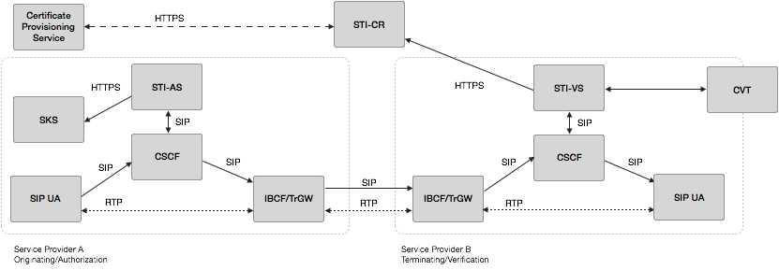
SHAKEN Reference Architecture
Analytics (CVT) could establish “reputation” at the national level, in addition to SP and user.
From ATIS-1000074

Slide 8
Next Steps
If the IPNNI supports this work item, I will bring draft text into the Austin meeting.
What is the preferred approach?
Revision to ATIS-1000087
New Technical Report

