Slide 1


Analysis of Network Outage Reports
Cybersecurity and Communications Reliability Division – Public Safety & Homeland Security Bureau
John Healy
December 2018

Slide 2
Data Source
Database snapshot as of November 8, 2018
NORS Final Outage Reports from January 1, 2013 through September 30, 2018 were used in the analysis

Slide 3
Frequency Trend Analyses
Past trend and seasonality effects
  Estimates used in trend chart
  Based on 3-year window (Jul 2015 – Jun 2018)
Most recent trend
  Comparison with past trend
  Based on 3-year window (Oct 2015 – Sep 2018)
Average monthly frequency in 3Q18
  Test if significantly different from expected frequency based on past trend and seasonality effects

Slide 4
Changes in Reporting Rules
December 2017
  DS3 Simplex duration threshold reduced to 4 days
February 2018
  OC3s replace DS3s as transport standard
  OC3 Non-Simplex threshold raised to 667 OC3 minutes
May 2018
  User minutes calculation for Wireless outages changed

Slide 5
OC3 Outage Reports
OC3 Non-Simplex Outage Reports
  Reason Reportable “667 OC3 minutes”
  DS3 Non-Simplex outage report
    DS3s > 2 or OC3s > 0
    DS3 minutes > 2000
OC3 Simplex Outage Reports
  Reason Reportable “OC3-Simplex greater than 4 Days”
  DS3 Simplex outage report
    DS3s > 2 or OC3s > 0

Slide 6
Analyses Using
OC3 and DS3 Outage Reports
OC3 Non-Simplex Outage Reports
  Included in all analyses
OC3 Simplex Outage Reports
  Analyzed separately
  Excluded from all other analyses unless noted otherwise
DS3 Simplex and DS3 Non-Simplex Reports
  Included in the analyses if they would have been reportable under the current rules

Slide 7
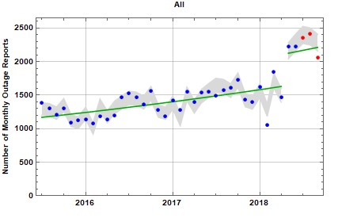
Frequency of Outages by Month
Monthly Trend
1.1%
(up from 1.0%)
Wireless Rule Change
3Q18 Monthly Average
2273.3
(significantly lower than expected)
Rule Change
26% increase

Slide 8
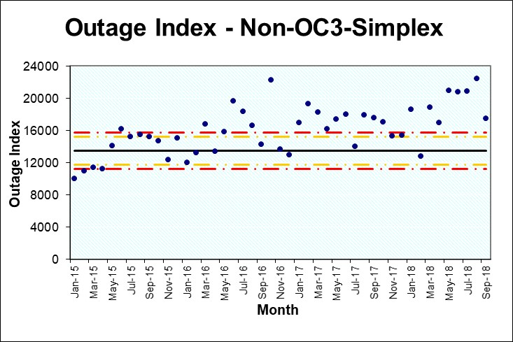
Outage Index
See ATIS-0100021 Analysis of FCC-Reportable Service Outage Data for a description of the method used to calculate the outage index.

Slide 9
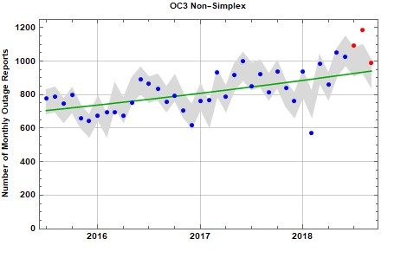
OC3 Non-Simplex
Monthly Trend
1.0%
(up from 0.8%)
3Q18 Monthly Average
1091.0
(significantly greater than expected)

Slide 10
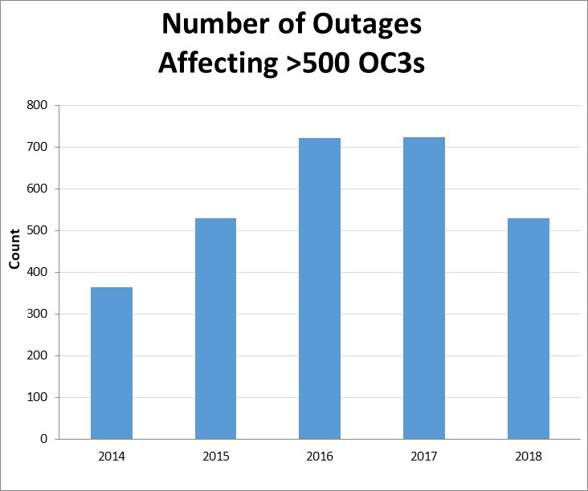
Big OC3 Outages

Slide 11
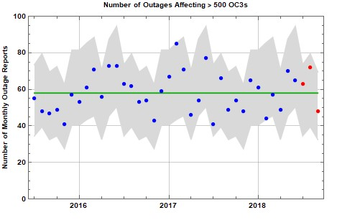
Big OC3 Outages
Monthly Trend
flat 0%
(unchanged)
3Q18 Monthly Average
61.0

Slide 12
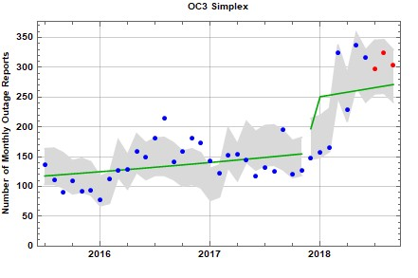
OC3 Simplex
Monthly Trend
flat 0%
(down from 1.0%)
3Q18 Monthly Average
308.7
Rule Change
89% increase
DurationRule Change

Slide 13
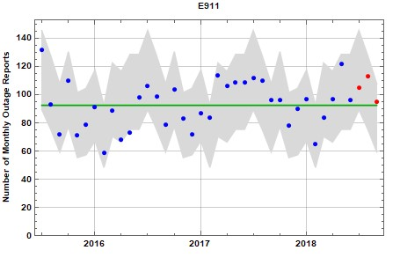
E911
Monthly Trend
flat 0.0%
(unchanged)
3Q18 Monthly Average
104.3

Slide 14
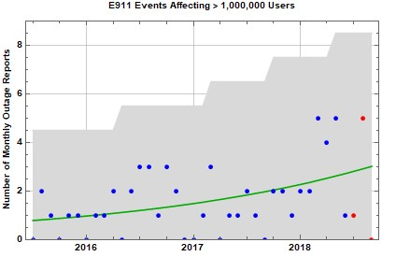
Very Large E911 Outages
Monthly Trend
flat 0%
(down from 3.6%)
3Q18 Monthly Average
2.0

Slide 15
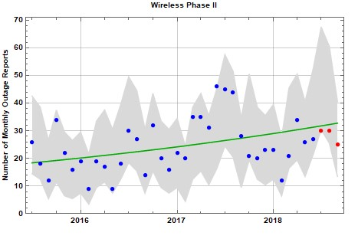
E911 – Phase 2 Events
Monthly Trend
flat 0%
(down from 1.5%)
3Q18 Monthly Average
28.3
(significantly lower than expected)

Slide 16
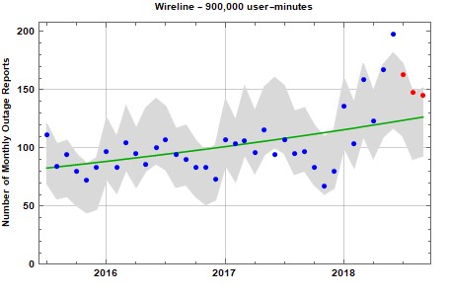
Wireline
Monthly Trend
1.6%
(up from 1.1%)
3Q18 Monthly Average
152.0
(significantly greater than expected)

Slide 17
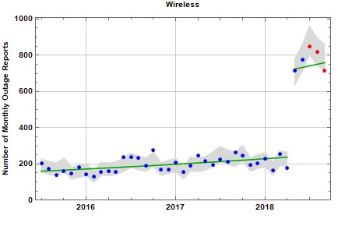
Wireless
Monthly Trend
1.1%
(down from 1.2%)
3Q18 Monthly Average
794.3
Rule Change
195% increase

Slide 18
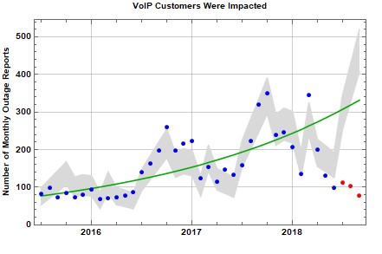
VoIP
Monthly Trend
2.3%
(down from 3.9%)
3Q18 Monthly Average
97.0
(significantly lower than expected)

Slide 19
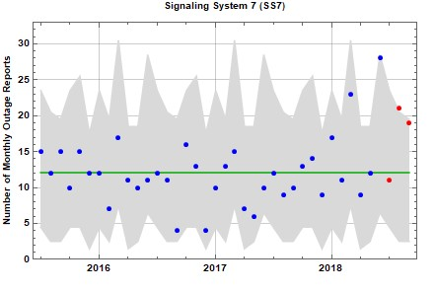
SS7
Monthly Trend
1.6%
(up from 0%)
3Q18 Monthly Average
17.0
(significantly greater than expected)

Slide 20
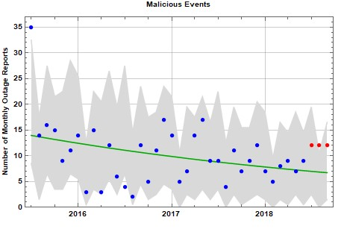
Malicious Events
Monthly Trend
flat 0%
(up from -1.9%)
3Q18 Monthly Average
12.0
(significantly greater than expected)

Slide 21
Malicious Activity
The figures for 2018 are through September.

Slide 22
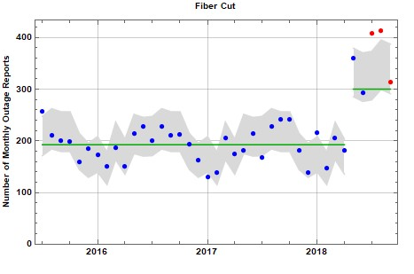
Fiber Cut
Monthly Trend
flat 0%
(unchanged)
3Q18 Monthly Average
378.0
(significantly higher than expected)
Rule Change
69% increase

Slide 23
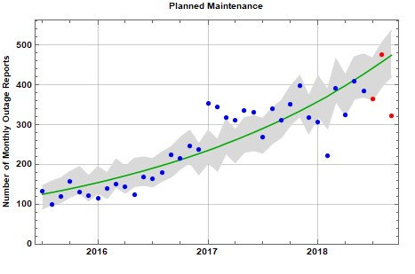
Planned Maintenance
Monthly Trend
3.3%
(down from 3.6%)
3Q18 Monthly Average
387.7
(significantly lower than expected)

Slide 24
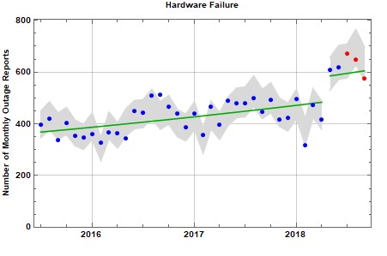
Hardware Failure
Monthly Trend
0.7%
(down from 0.8%)
3Q18 Monthly Average
631.3
Rule Change
18% increase

Slide 25
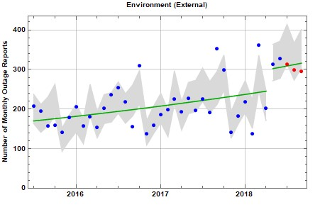
Environmental – External
Monthly Trend
1.1%
(unchanged)
3Q18 Monthly Average
302.7
(significantly lower than expected)
Rule Change
13% increase

Slide 26
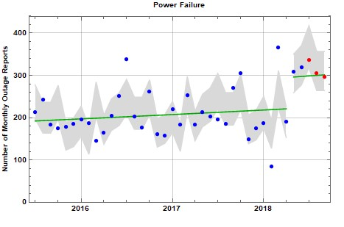
Power Failure
Monthly Trend
0.4%
(unchanged)
3Q18 Monthly Average
312.7
Rule Change
29% increase

Slide 27
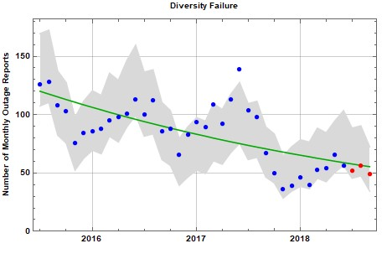
Diversity Failure
Monthly Trend
-2.4%
(down from -2.0%)
3Q18 Monthly Average
52.3

Slide 28
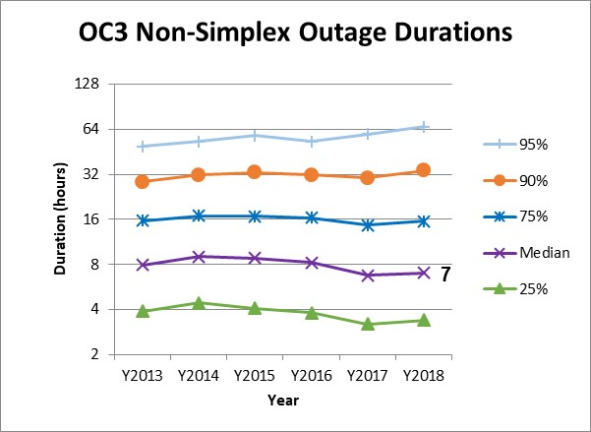

Duration Trends: OC3 Non-Simplex
The duration of OC3 Non-Simplex outages is statistically higher in 2018 compared with 2017 (using a Mann-Whitney test).

Slide 29
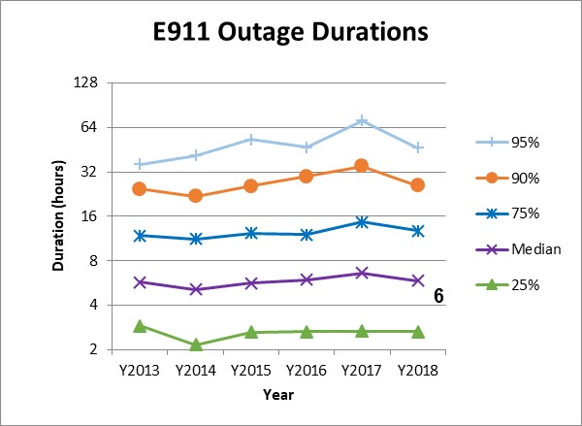
Duration Trends: E911
The duration of E911 outages is statistically unchanged in 2018 compared with 2017 (using a Mann-Whitney test).
7

Slide 30
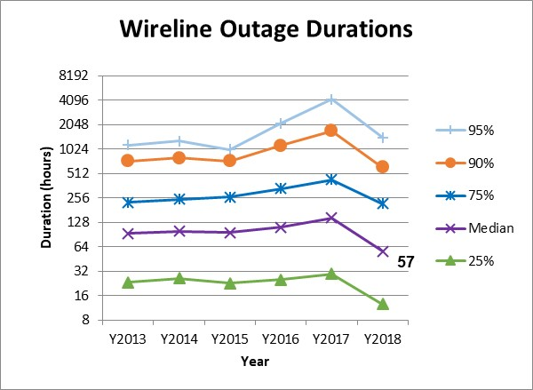
Duration Trends: Wireline
The duration of wireline outages is statistically lower in 2018 compared with 2017 (using a Mann-Whitney test).

Slide 31
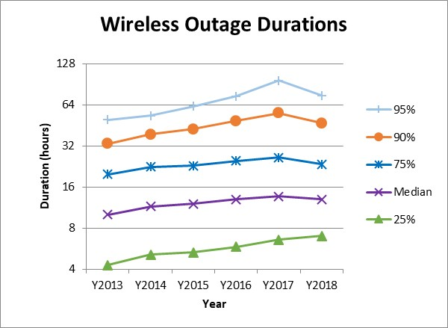
Duration Trends: Wireless
The duration of wireless outages is statistically unchanged in 2018 compared with 2017 (using a Mann-Whitney test).
13

Slide 32
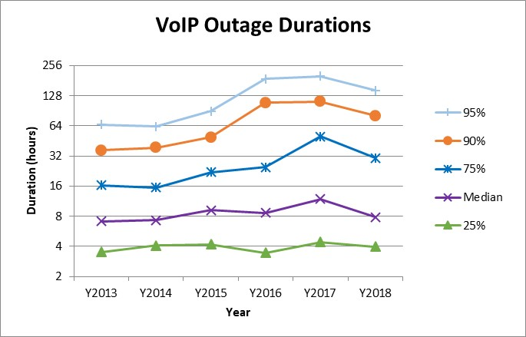
Duration Trends: VoIP
The duration of VoIP outages is statistically lower in 2018 compared with 2017 (using a Mann-Whitney test).
8

Slide 33
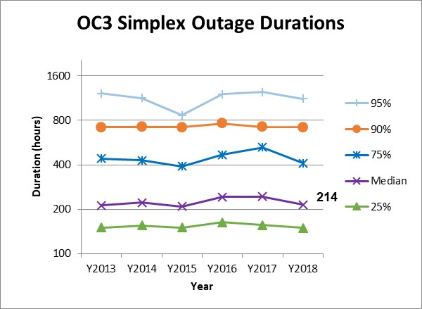
Duration Trends: OC3 Simplex
(outages with duration 5 days or more)
The duration of OC3 Simplex outages is statistically lower in 2018 compared with 2017 (using a Mann-Whitney test).

Slide 34
Test for Trend in Event Duration
34
Non-OC3-Simplex Outages
Data from October 2015 thru September 2018
OC3-Simplex Events Only
(5 days duration minimum)
Data from October 2015 thru September 2018
Rank Correlation of duration with date is .008 and is not statistically significant.
Rank Correlation of duration with date is -.042 and is statistically significant.
Conclusion: Durations of Non-OC3-Simplex Outages have not changed over the period from October 2015 thru September 2018.
Conclusion: Durations of OC3-Simplex Events have decreased over the period from October 2015 thru September 2018.

Slide 35
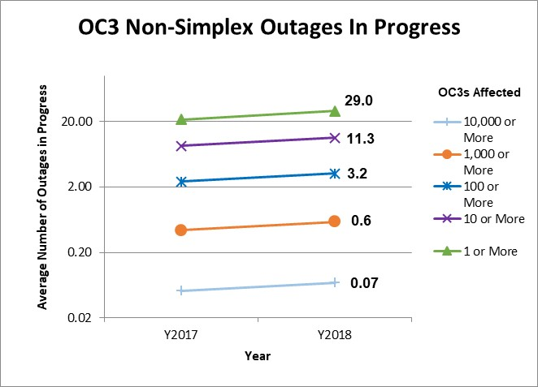
Outages In Progress
OC3 Non-Simplex

Slide 36
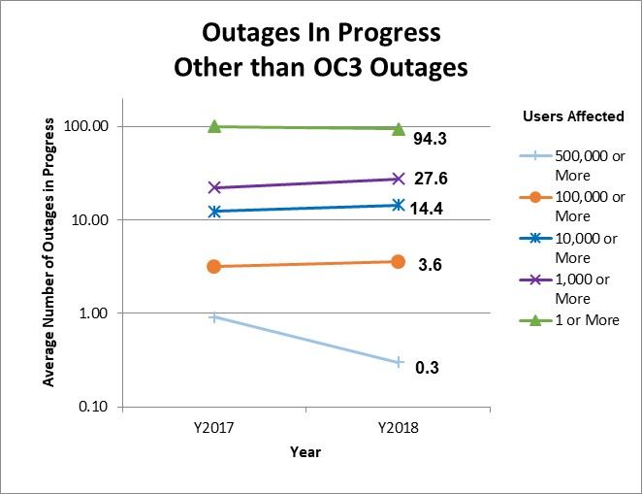
Outages In Progress
Other Service-Affecting Outages

Slide 37
NORS Transition
Hold monthly NORS Coordinator meetings
Update the NORS User Manual
Implemented DS3 Simplex threshold change in December 2017
Implemented change from DS3s to OC3s in February 2018
Implemented the rule change on how to count the number of wireless users in May 2018

