Slide 1
Reference Architecture and Call Flow Example for SIP RPH Signing
August 07, 2018
ATIS IPNNI Task Force
Ray P. Singh
formerly Applied Communication Sciences

Slide 2
Overview
Proposed Functional Architecture for SIP RPH Signing
Leverage the SHAKEN infrastructure being implemented by carriers for Telephone Number (TN) signing specified in ATIS-1000074 where feasible
SIP RPH Call Flow Example
Highlight RPH signing aspects in a typical NS/EP NGN-PS call flow

Slide 3
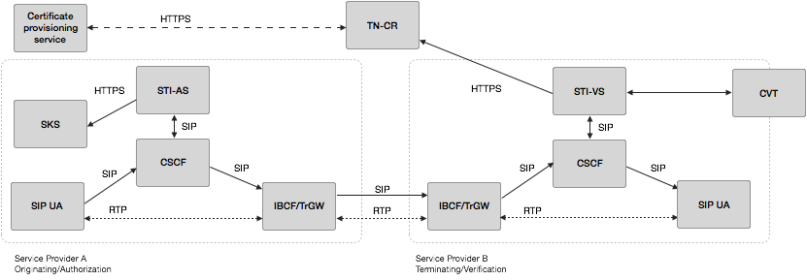
Background: SHAKEN Reference Model [ATIS-1000074] Telephone Number Signing
SIP UA: SIP User Agent
CSCF: IMS/Call Session Control Function
IBCF/TrGW: Interconnection Border Control Function/Transition Gateway
STI-AS: Secure Telephone Identity - Authentication Service
STI-VS: Secure Telephone Identity - Verification Service
CVT: Call Validation Treatment
SKS: Secure Key Store
TN-CR: Telephone Number Certificate Repository (TN-CR)

Slide 4
Proposed Reference Model for RPH Signing
Certificate provisioning service
Certificate provisioning service
HTTPS
SKS
CVT
HTTPS
TAS/ NS/EP NGN-PS AS
STI-AS
RPH - AS
RPH - VS
TAS/NS/EP NGN-PS AS
STI-VS
SIP
SIP
SIP
SIP
CSCF
SIP
SIP
CSCF
SIP
SIP
SIP
SIP
RTP
SBC-I
(IBCF/TrGW)
SIP
RTP
SIP UA
SIP UA
RTP
SBC-I
(IBCF/TrGW)
Service Provider A
(NS/EP NGN-PS Origination/Authentication)
IPNNI
Service Provider B
(NS/EP NGN-PS Termination/Verification)
TAS: Telephone Application Server SBC-I: Session Border Controller - Interconnection
NS/EP NGN-PS AS: NS/EP NGN-PS Application Server RPH-AS: RPH Authentication Service
RPH-VS: RPH Verification Service IPNNI: IP Network-to-Network Interconnection

Slide 5
Call Flow: IPNNI Origination (Voice & Video)
S-CSCF
/I-CSCF
TAS / NS/EP NGN-PS AS
UE
EPS
PCRF
P-CSCF
HSS
RPH-AS
Term NW
Prior Condition: Originating UE registered and subscribed to NGN-PS (i.e., GETS-FC service)
1. INVITE
2. INVITE
ets.x
Includes RPH provisioned ets.x
3. INVITE
ets.x
Authorization and Service control.
If authorized, the AS removes FC from Request URI and inserts Service User’s Priority Level in RPH wps namespace and aligns ets namespace
Optional query for subscription info
4. UDR
DRMP
5. UDA
ets.x wps.y
6. INVITE
Call identified as inter-network and sent to RPH-AS for signing
7. INVITE
ets.x wps.y
8. INVITE
ets.x wps.y
ppt [rph:"auth“]
RPH is signed using PASSPorT type “rph” and included in SIP Identity Header
9. INVITE
ets.x wps.y
ppt [rph:"auth“]
ets.x wps.y
10. 183 Progress
11. 183 Progress
ets.x wps.y
ets.x wps.y
12. 183 Progress
ets.x wps.y
13. 183 Progress
MPS ; R-P ; DRMP
14. AAR
Note, call flow is clipped,
But that portion not needed for this presentation
15. AAA
16. 183 Progress
PCRF determines QoS-Information for audio and video based on MPS-ID, Reservation-Priority and available ARPs for NS/EP
17. PRACK, 200 OK (PRACK)
18. Media Bearer Establishment
19. UPDATE, 200 OK (UPDATE)
20. Remaining SIP message exchanges: 180 RINGING, PRACK, 200 OK (PRACK), 200 OK, ACK
Audio, Video Media Bearers
Prevent PPT from jumping to next slide

Slide 6
Call Flow: IPNNI Termination (Voice & Video)
TAS / NS/EP NGN-PS AS
UE
EPS
PCRF
P-CSCF
HSS
RPH-VS
S-CSCF/
I-CSCF
Orig NW
Prior Condition: Terminating UE registered
ets.x wps.y
ppt [rph:"auth“]
1. INVITE
ppt [rph:"auth“]
ets.x wps.y
2. INVITE
Call sent to RPH-VS for verification
ets.x wps.y
3. INVITE
Validation is successful and Invite is forwarded within terminating network with RPH
4. LOC_QUERY
5. LOC_QUERY RESP
6. INVITE
ets.x wps.y
7. INVITE
8. 183 Progress
MPS-ID ; R-P ; DRMP
9. AAR
10. AAA
11. 183 Progress
ets.x wps.y
PCRF determines QoS-Information for audio and video based on MPS-ID, Reservation-Priority and available ARPs for NS/EP
Note, call flow is clipped,
But that portion not needed for this presentation
ets.x wps.y
12. 183 Progress
11. PRACK, 200 OK (PRACK)
12. Media Bearer Establishment
13. UPDATE, 200 OK (UPDATE)
14. Remaining SIP message exchanges: 180 RINGING, PRACK, 200 OK (PRACK), 200 OK, ACK
Audio, Video Media Bearers
Prevent PPT from jumping to next slide

Slide 7
Thank You

