Slide 1
Analysis of Network Outage Reports
Cybersecurity and Communications Reliability Division – Public Safety & Homeland Security Bureau
John Healy
May 2016

Slide 2
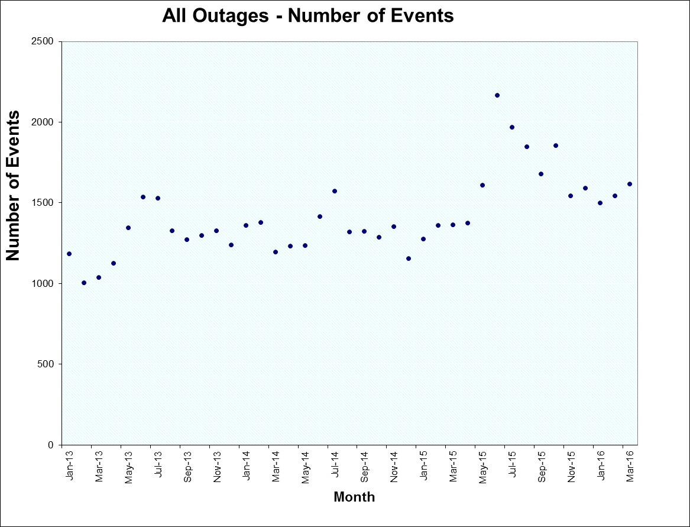
Frequency of Outages by Month

Slide 3
Standards for Outage Frequencies
Took average of January 2013 through December 2013 as the standard

Slide 4
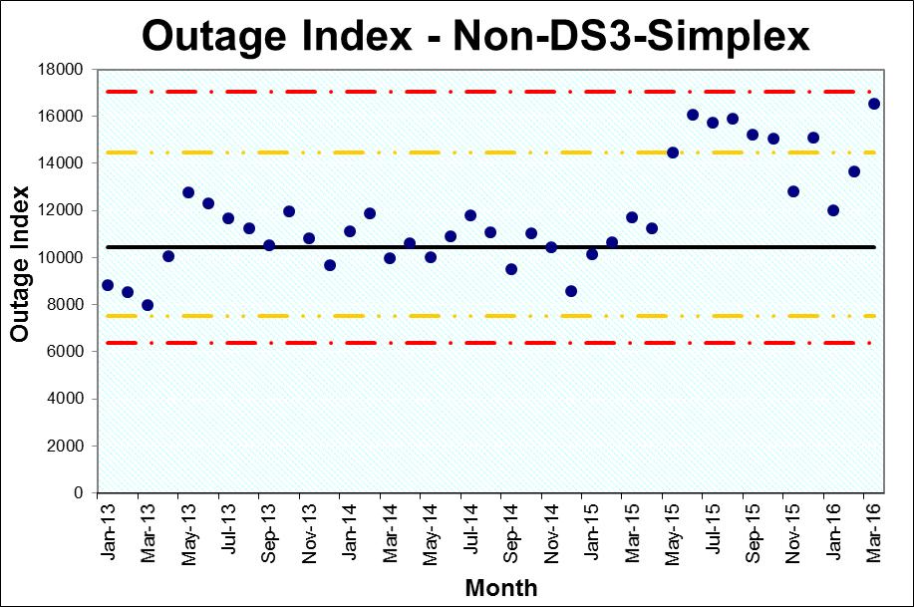
Outage Index – For All Outages Except DS3-Simplex
See ATIS-0100021 Analysis of FCC-Reportable Service Outage Data for a description of the method used to calculate the outage index.

Slide 5
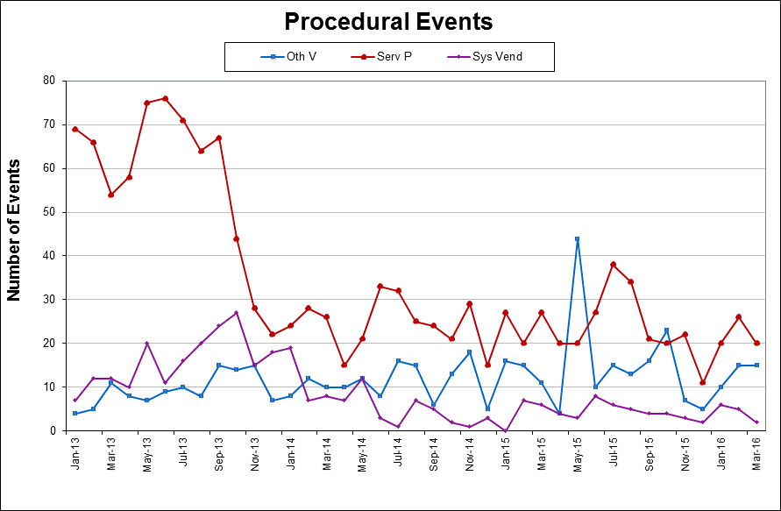
Procedural Events by Source

Slide 6
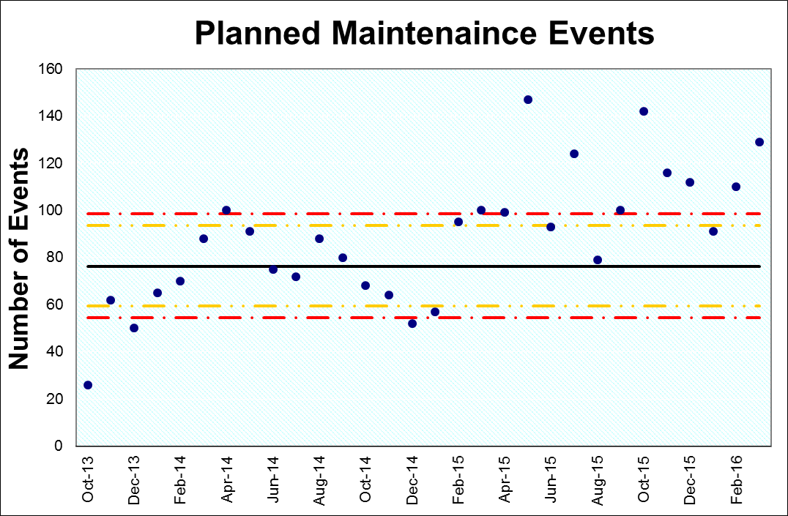
New Planned Maintenance Cause Codes

Slide 7
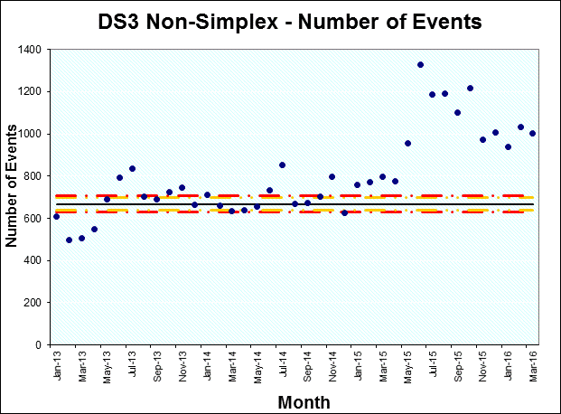
DS3 (Non-Simplex) Events

Slide 8
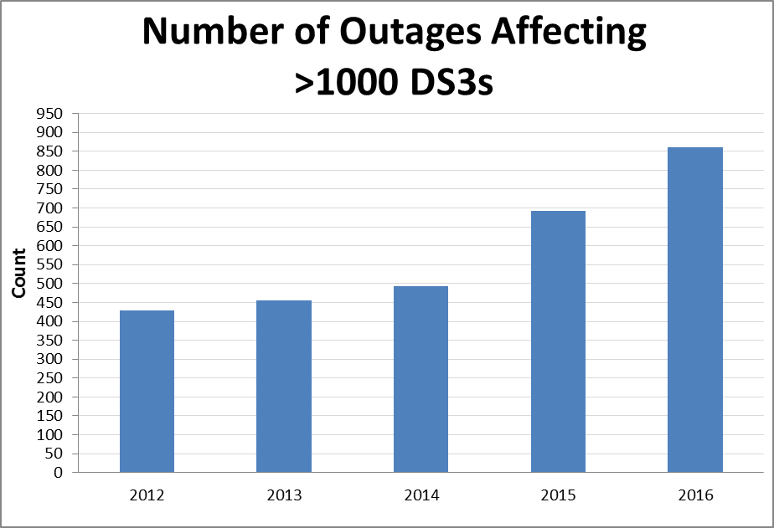
Big DS3 Outages

Slide 9
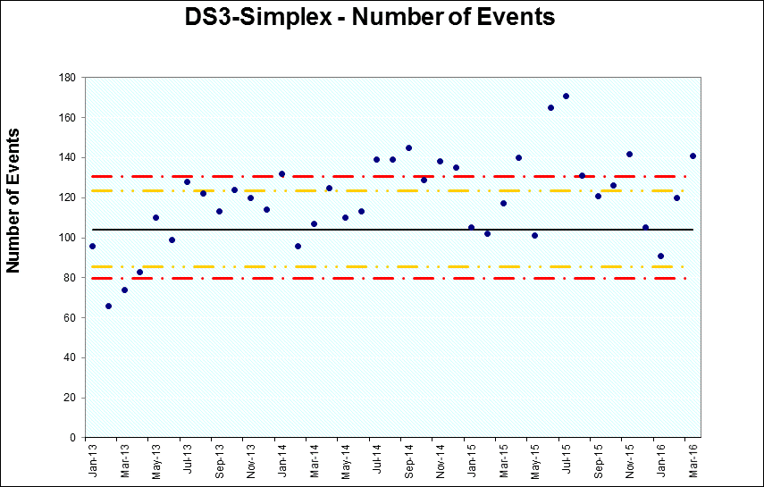
DS3-Simplex

Slide 10
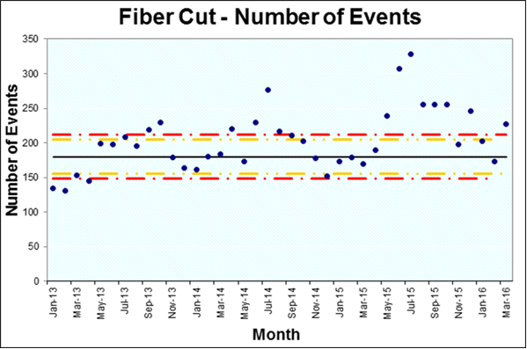
Fiber Cut

Slide 11
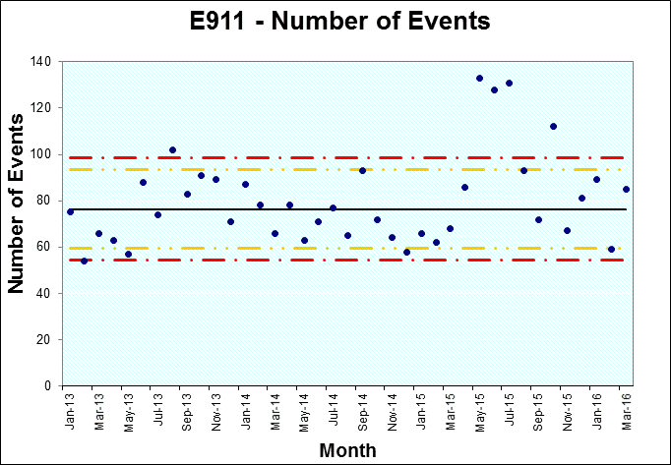
E911

Slide 12
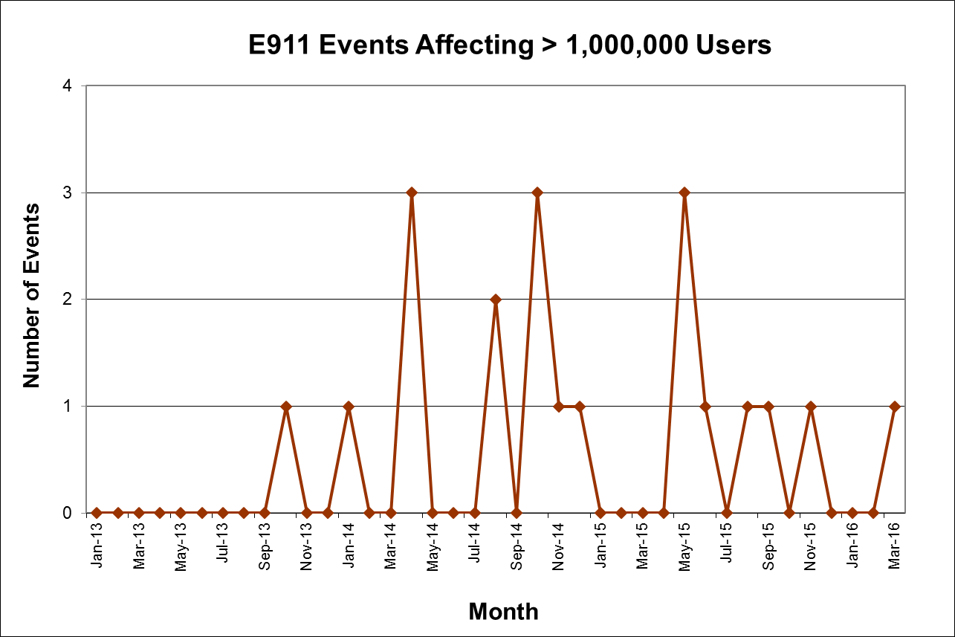
Very Large E911 Outages

Slide 13
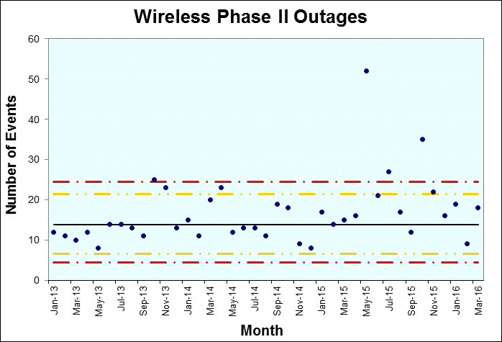
E911 – Phase 2 Events

Slide 14
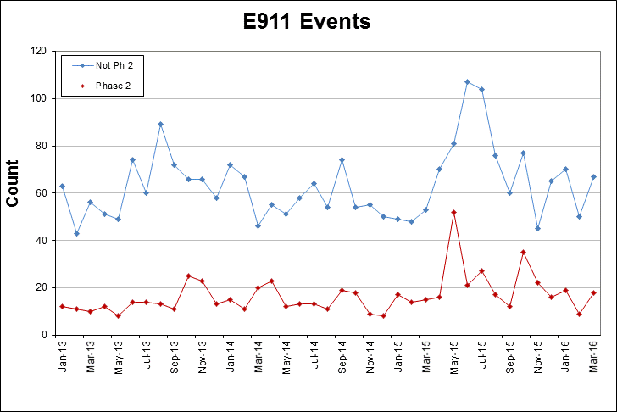
Phase 2 vs. All Other E911 Outages

Slide 15
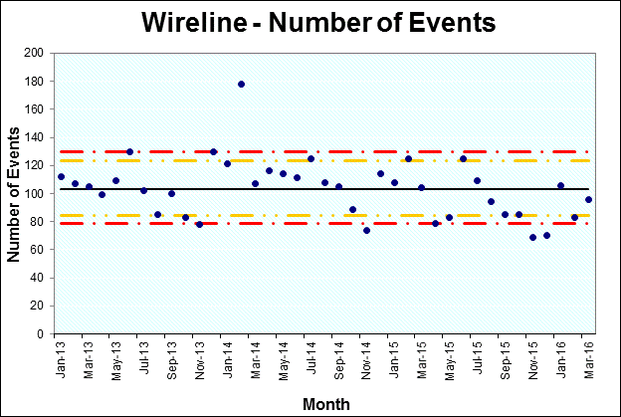
Wireline
Wireline outages are all outages for which the Reason Reportable was at least 900,000 wireline user-minutes.

Slide 16
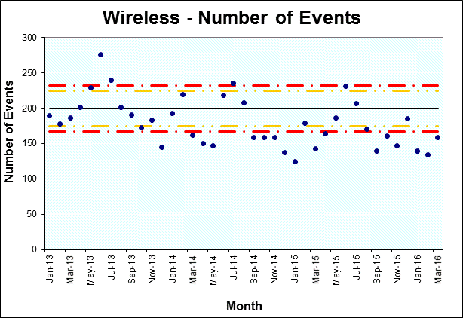
Wireless

Slide 17
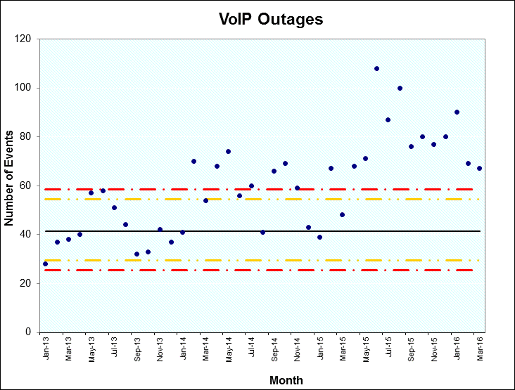
VoIP Reporting

Slide 18
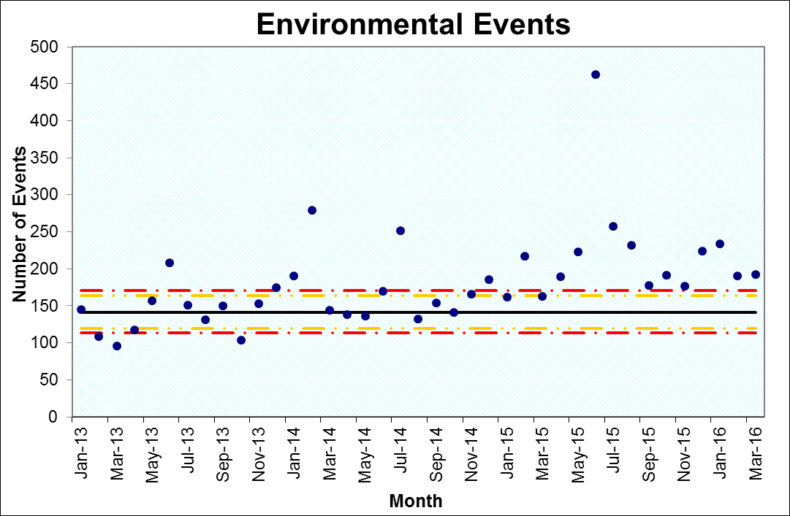
Environmental – External

Slide 19
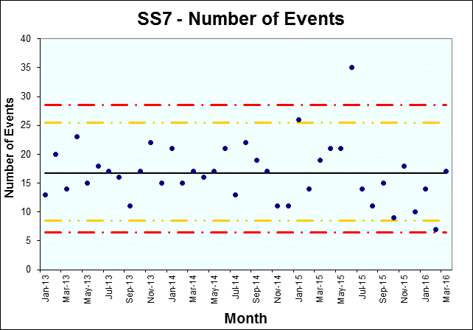
SS7

Slide 20
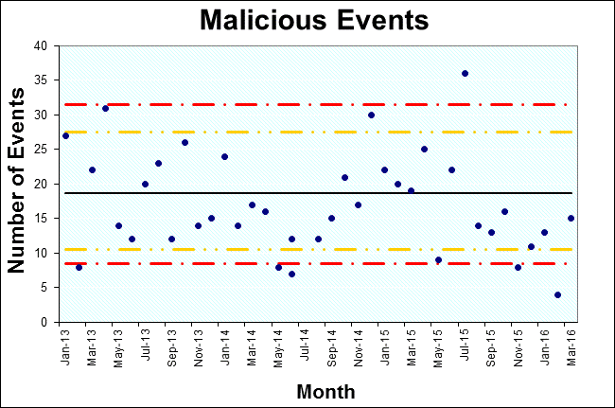
Malicious Events

Slide 21
Malicious Activity
 | Vandalism | Cable Theft | Gun Shots | Total Malicious Events
2012 | 35% (83) | 8% (18) | 7% (15) | 207
2013 | 37% (83) | 4% (9) | 9% (22) | 224
2014 | 51% (99) | 6% (11) | 11% (22) | 193
2015 | 46% (21) | 11% (4) | 13% (6) | 215
2016 | 18% (6) | 0% (0) | 25% (9) | 35
The figures for 2016 are thru March.

Slide 22
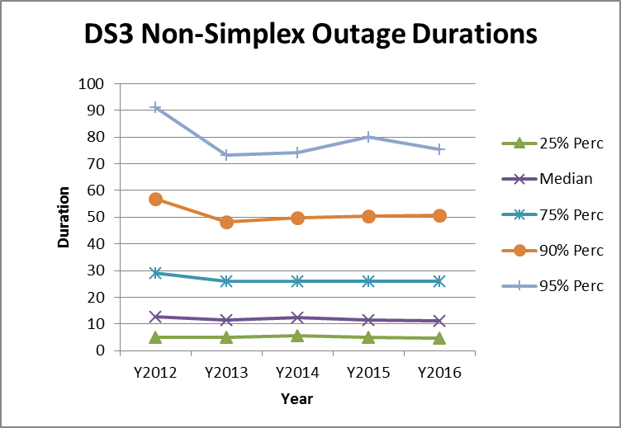
Duration Trends: DS3 Non-Simplex
The duration of DS3 non-simplex outages is statistically unchanged in 2016 compared with 2015 (using a Mann-Whitney test).

Slide 23
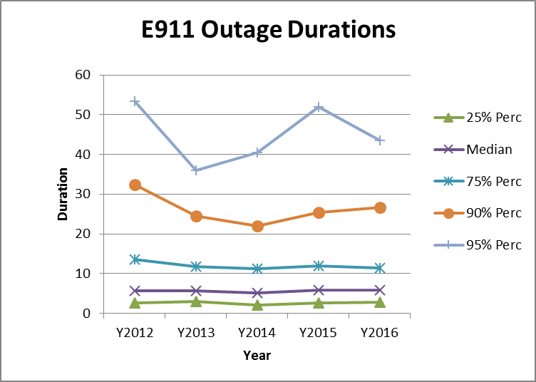
Duration Trends: E911
The duration of E911 outages is statistically unchanged in 2016 compared with 2015 (using a Mann-Whitney test).

Slide 24
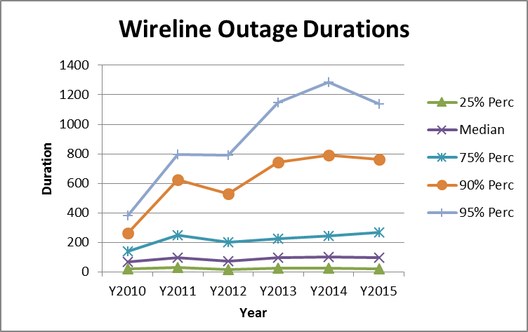
Duration Trends: Wireline
The duration of wireline outages is statistically unchanged from 2015 to 2016 (using a Mann-Whitney test).

Slide 25
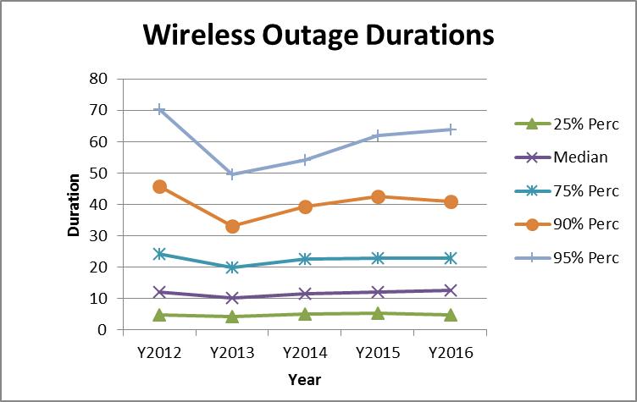
Duration Trends: Wireless
The duration of wireless outages is statistically unchanged from 2015 to 2016 (using a Mann-Whitney test).

Slide 26
Test for Trend in Event Duration
Non-DS3-Simplex Outages
Data from 1/14 thru 03/16
DS3-Simplex Events Only
Data from 1/14 thru 03/16
Rank Correlation of duration with date is -.011 and is significant at the .01 level
Rank Correlation of duration with date is -.017 and is not significant at the .05 level
Conclusion: Non DS3-Simplex Outages are shorter in duration from 1/14 to 03/16
Conclusion: DS3-Simplex Events are unchanged in duration from 1/14 to 03/16

Slide 27
NORS Transition
NORS coordinators began to test the new system in April
Public Notice about NORS transition went out on May 10
June 2 - Training session on the new NORS
July 5 – Testing of the new NORS ends
July 20 – Cutover to the new NORS

Slide 28
NRSC Activities
Current Teams
Best Practices Team
Outage Reporting Advisory Team
Improvements to the NORS System
Improvements to the template
Recommended ways to communicate information
Improvements to NORS/DIRS manuals
IP Transition Team
Consistent Use of Cause Codes

