Slide 1
ATIS Overview
December 9, 2015

Slide 2
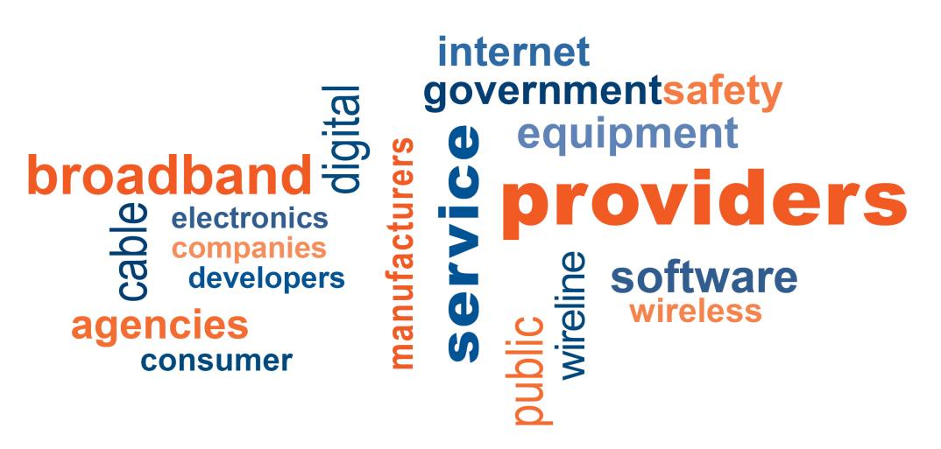
ATIS in Brief
Alliance for Telecommunications Industry Solutions (ATIS):
With a focus on interoperability and innovation, ATIS defines and advances technology solutions and standards to support the timely rollout of new products and services.
New collage here

Slide 3
ATIS Broad Ecosystem
Service Providers*
Systems Integrators
Platform Providers
… and 40 more
… and 70 more
… and 10 more
* ATIS Affiliate members grouped here for presentation purposes

Slide 4
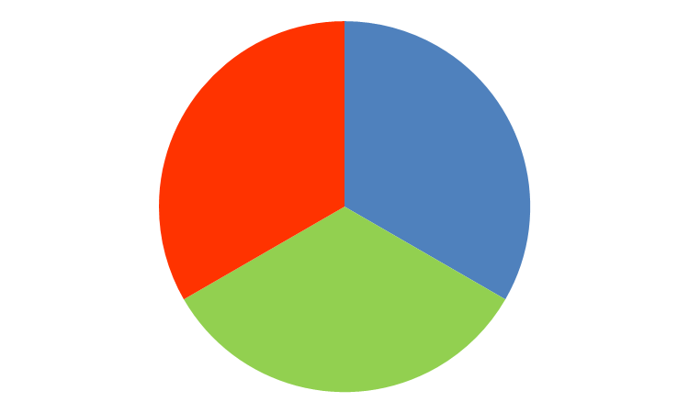
ATIS Enables Innovation Transformation to a Wide Scope and Scale
Architecture and Services: Framework for Success
Information Infrastructure: Numbering & Metadata
ATIS Innovation Engines:
1) Originating from Executive Board
2) Originating from Technical Creators
Operational Excellence: Manage Implementation and Risk

Slide 5
ATIS Programs
Business Program View
Network Evolution
Services Marketplace
Policy
Architecture and Services
Emergency Services Interconnection Forum (ESIF); Packet Technologies and Systems Committee (PTSC); Cloud Services Forum (CSF); Wireless Technologies and Systems Committee (WTSC); Device Solutions Initiative (DSI); Open Web Alliance; NFV Forum; Intelligent Peering Landscape Team (IPLT); 5G; oneM2M Open Source; Neutral Host; WebRTC Signaling Server; Wi-Fi Emergency Calling
Information Infrastructure
Industry Numbering Committee (INC); Ordering and Billing Forum (OBF); Automatic Identification and Data Capture Committee (AIDC); IMSI Oversight Council (IOC); SMS/800 Number Administration Committee (SNAC); Telecom Management and Operations Committee (TMOC); Testbeds; Number Assignment / Distributed Registry; Calling Party Anti-Spoofing
Technology View
Operational Excellence
Copper/Optical Access Synchronization and Transport Committee (COAST); Next Generation Interconnection Interoperability Forum (NGIIF); Network Reliability Steering Committee (NRSC); Sustainability in Telecom: Energy and Protection Committee (STEP); Cybersecurity

Slide 6
Why members join- some examples
LEARN - While companies are not new to either telecom or broadband, they are getting a lot of out of their ATIS membership in regards to the many issues and changes that are affecting the industry.
INFLUENCE - You can drive the agenda because all members have the opportunity to do so. ATIS is seen by members, large and small, as a way to get work done, for the benefit of their organizations, by the best and brightest minds in telecom.
SHAPE – In a collaborative environment, that seeks to manage market factors and position advocacy, ATIS accommodates various perspectives to build a solution.

Slide 7
ATIS Service Provider Members

Slide 8
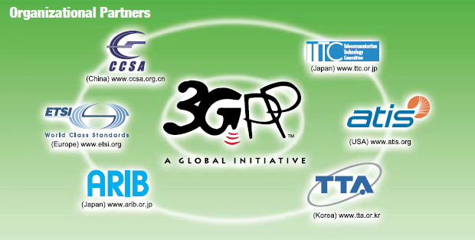
ATIS Global Initiatives with Partners
3GPP - Founding and Organizational Partner
oneM2M – Founding Partner
About a quarter of ATIS members are also 3GPP members
15 organizations participate thru ATIS; there is currently no additional fee

Slide 10
Become an NRSC Member
To learn more about NRSC initiatives and the advantages of participating through ATIS, please contact:
Jackie Voss, ATIS Manager - Global Standards Development (jvoss@atis.org)
- or –
Rich Moran, Director of Membership (rmoran@atis.org)

