Slide 1
Analysis of Network Outage Reports
Cybersecurity and Communications Reliability Division – Public Safety & Homeland Security Bureau
John Healy
February 2015

Slide 2
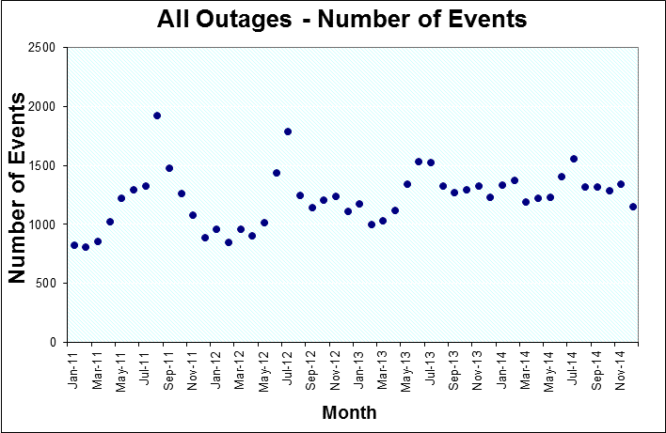
Frequency of Outages by Month

Slide 3
Standards for Outage Frequencies
Took average of January 2011 through December 2011 as the standard

Slide 4
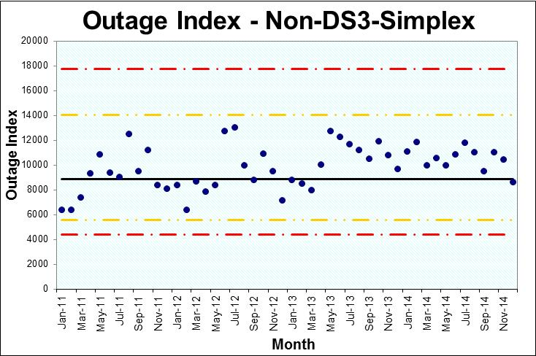
Outage Index – For All Outages Except DS3-Simplex
See ATIS-0100021 Analysis of FCC-Reportable Service Outage Data for a description of the method used to calculate the outage index.

Slide 5
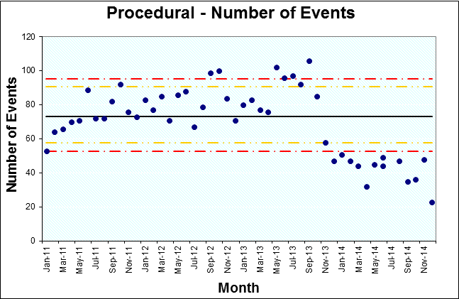
Procedural Events
Many of these events are related to Planned Maintenance. (We will not include this chart next time)
Procedural events are ones which have a procedural root cause.

Slide 6
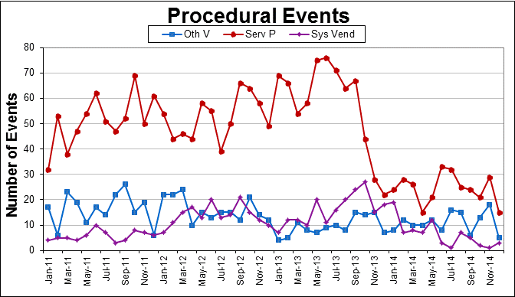
Procedural Events by Source

Slide 7
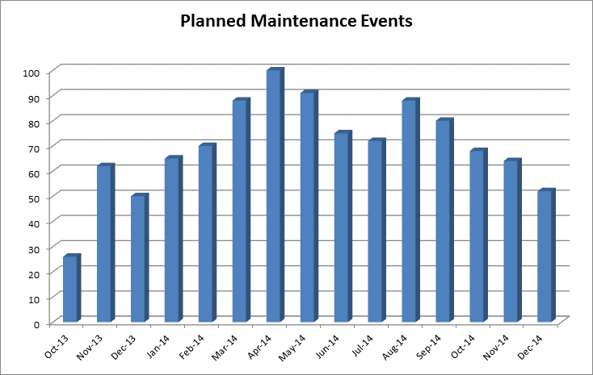
New Planned Maintenance Cause Codes

Slide 8
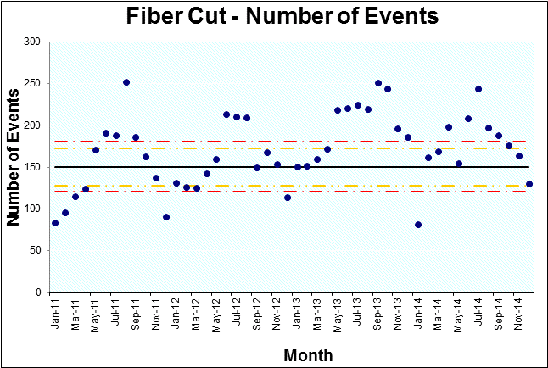
Fiber Cut

Slide 9
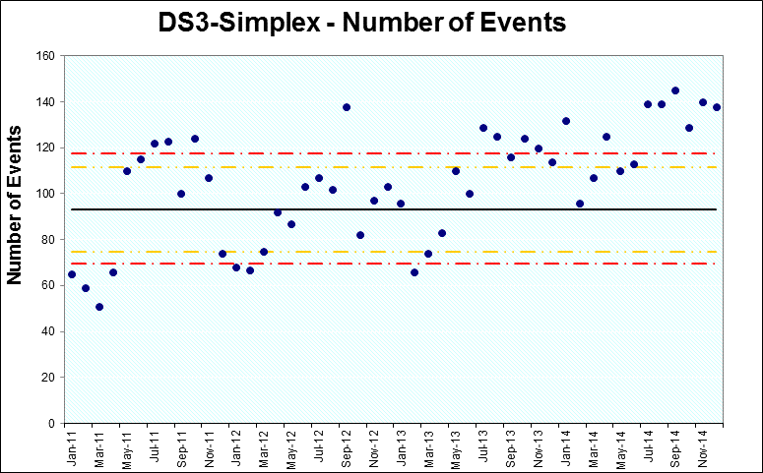
DS3-Simplex

Slide 10
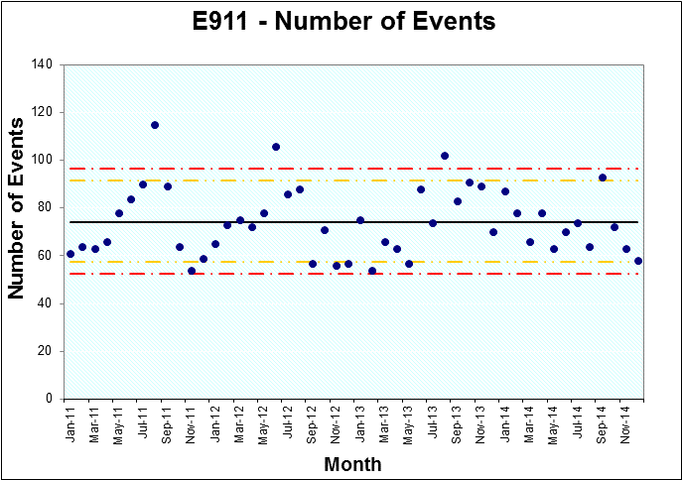
E911

Slide 11
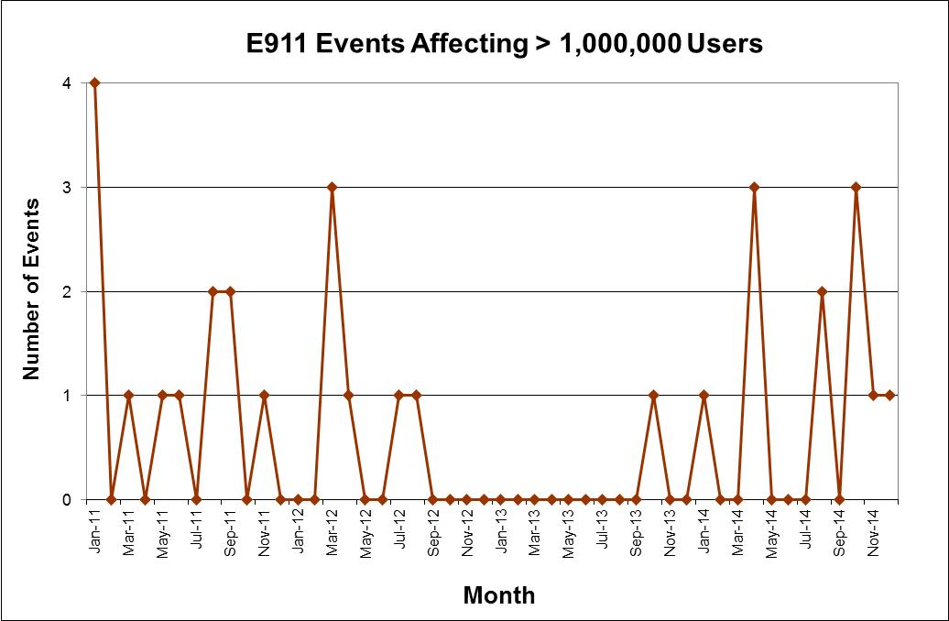
Very Large E911 Outages

Slide 12
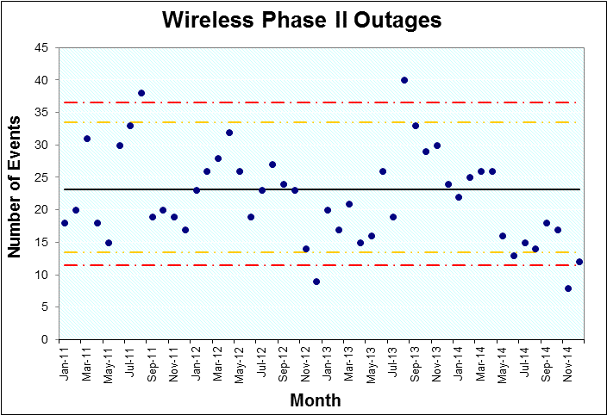
E911 – Phase 2 Events

Slide 13
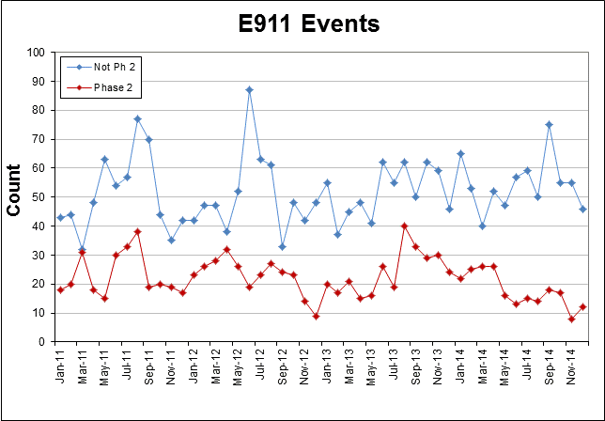
Phase 2 vs. All Other E911 Outages

Slide 14
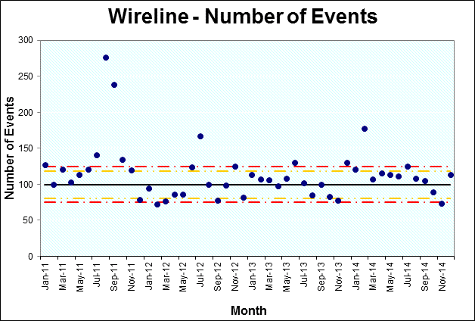
Wireline
Wireline outages are all outages for which the Reason Reportable was at least 900,000 wireline user-minutes.

Slide 15
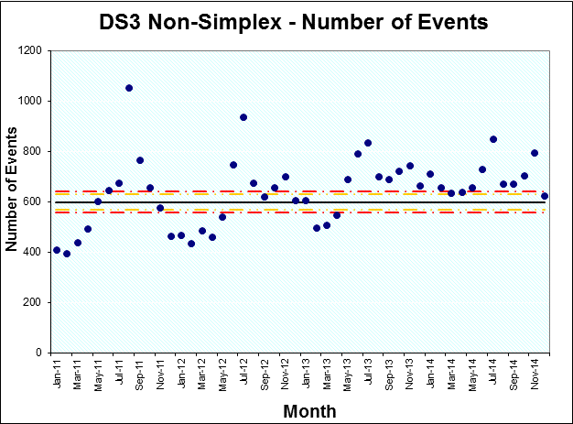
DS3 (Non-Simplex) Events

Slide 16
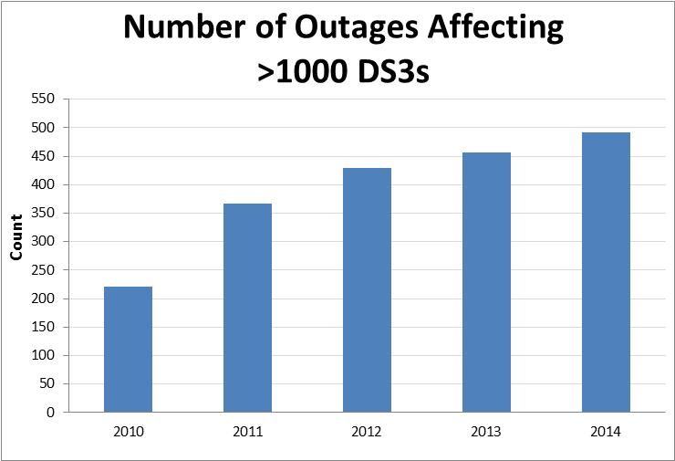
Big DS3 Outages

Slide 17
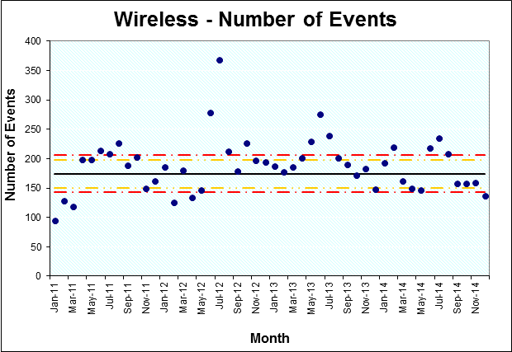
Wireless

Slide 18
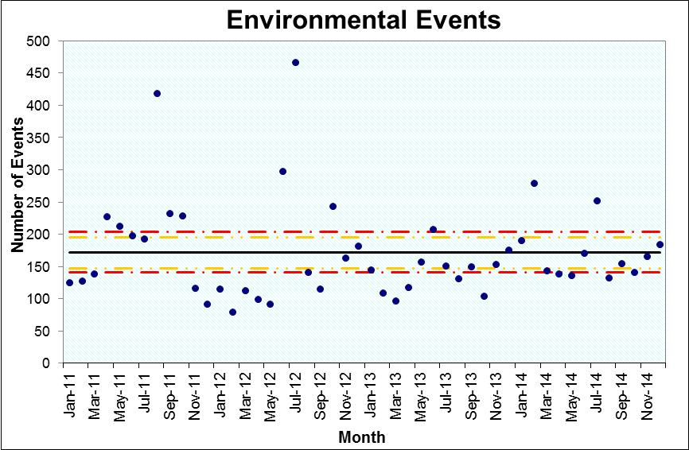
Environmental – External

Slide 19
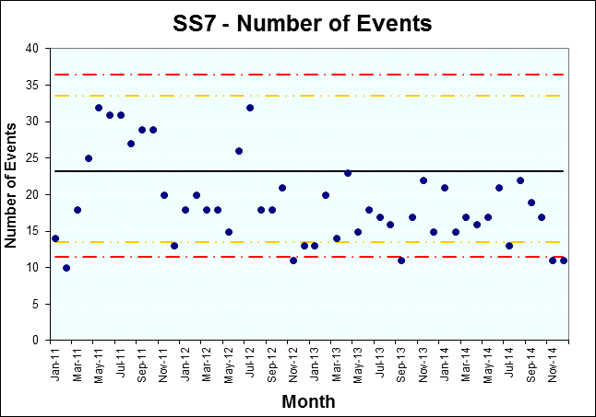
SS7

Slide 20
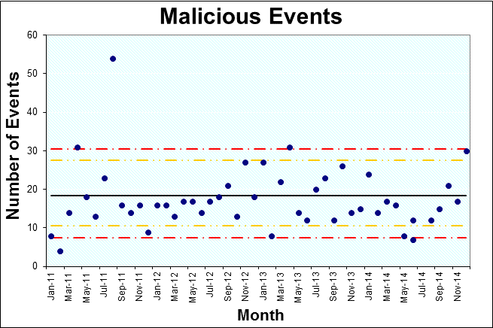
Malicious Events

Slide 21
Malicious Activity

Slide 22
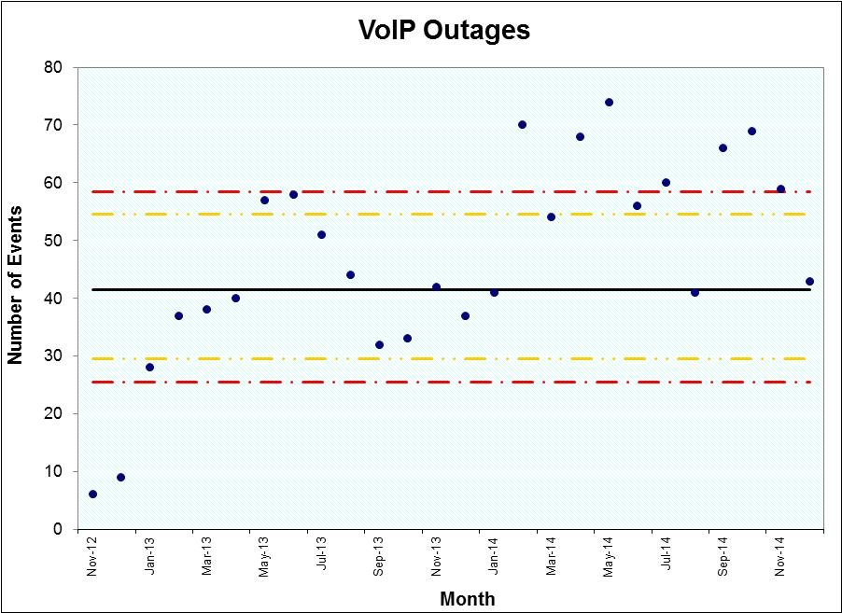
VOIP Reporting

Slide 23
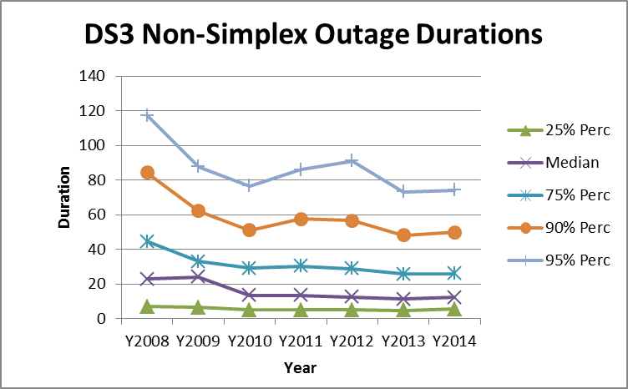
Duration Trends: DS3 Non-Simplex

Slide 24
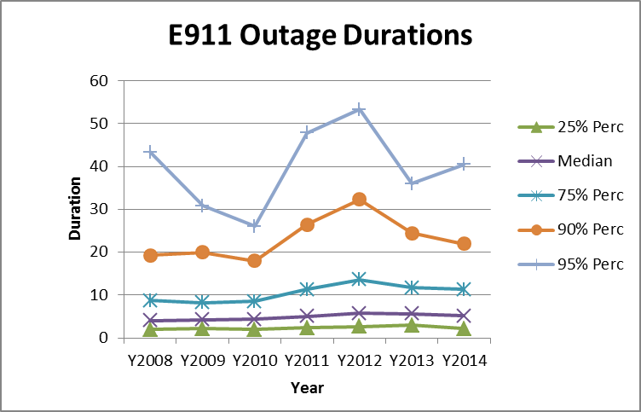
Duration Trends: E911

Slide 25
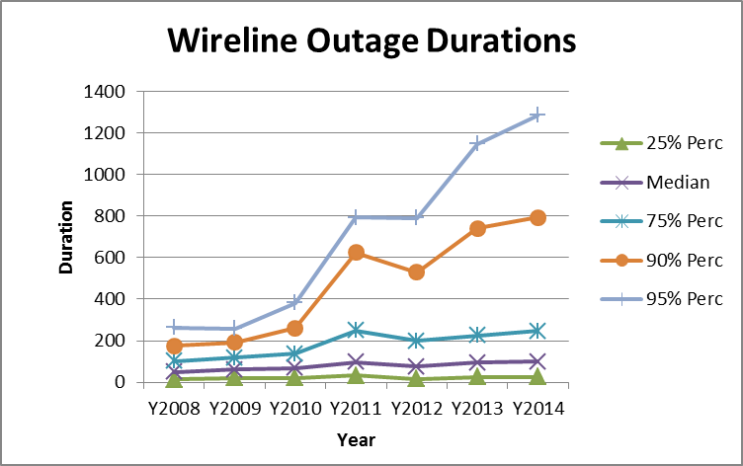
Duration Trends: Wireline

Slide 26
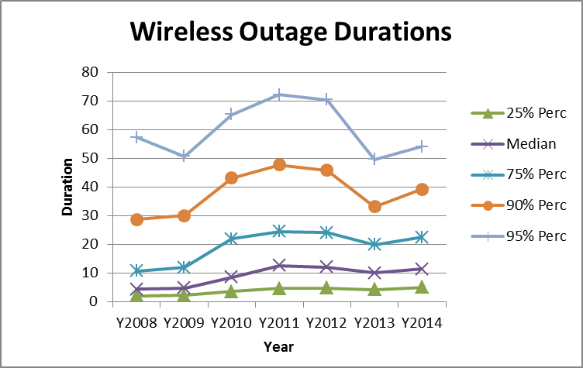
Duration Trends: Wireless

Slide 27
Test for Trend in Event Duration
Non-DS3-Simplex Outages
Data from 1/12 thru 12/14
DS3-Simplex Events Only
Data from 1/12 thru 12/14
Rank Correlation of duration with date is .001 and is not significant
Rank Correlation of duration with date is .011 and is not significant
Conclusion: Non DS3-Simplex Outages are unchanged in duration from 1/12 to 12/14
Conclusion: DS3-Simplex Events are unchanged in duration from 1/12 to 12/14

Slide 28
Changes to NORS/DIRS
Changes to NORS/DIRS:
Added ability to send text messages when DIRS is activated.
Comments and suggestions are greatly appreciated

Slide 29
NRSC Activities
Current Teams
Best Practices Team
Outage Reporting Advisory Team
Improvements to the NORS System
Improvements to the template
Recommended ways to communicate information
Improvements to NORS/DIRS manuals
Fiber Cut Team (Done)
IP Transition Team
Planned Maintenance Team: Examine planned maintenance events; recommend ways to upgrade the system without affecting service

